Slide 1



Child and Adolescent Psychiatry Education and Support Program for Primary Care Providers
An Update on
Child Mental Health
Jeff Daly, MD
Four Winds Hospital, Saratoga Springs, NY
The CAPES Program for Primary Care Physicians is sponsored by the Four Winds Foundation,
the designated Region 2 Provider of Project TEACH, a New York State OMH initiative.
.
Notes:
20-25 slides
Highlight the reviews, sample of tools, highlight of guidelines, psychoeducation, communication form

Slide 2
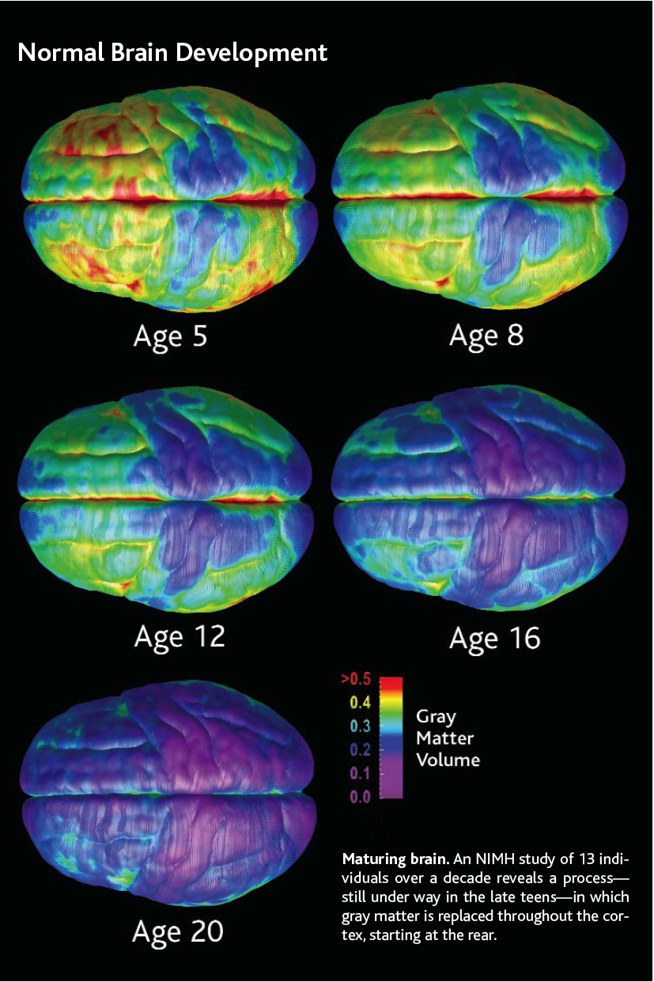
Brain Development
Between 6-15 years, extreme growth (to 80%) occurs at the collosal isthmus that supports associative relay, while considerable synaptic pruning occurs
Brain myelination increases 100% during the teenage years
Dopamine (DA), norepinephrine (NE), and serotonin (5-HT) transmitter systems in the brain continue to develop into one’s 20s
Thompson PM, et al. Nature. 2000;404(6774):190-193.
Benes FM, et al. Arch Gen Psychiatry. 1994;51(6):477-484.

Slide 3
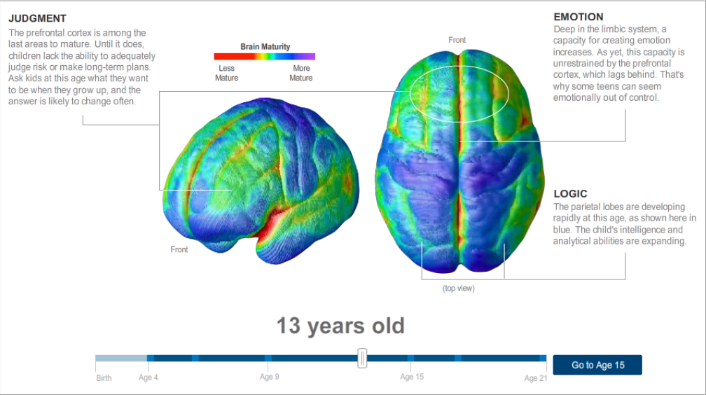

13

Slide 4

"When I was a boy of 14, my father was so ignorant I could hardly stand to have the old man around. But when I got to be 21, I was astonished at how much the old man had learned in seven years."
-- Mark Twain

Slide 5
21

Slide 6
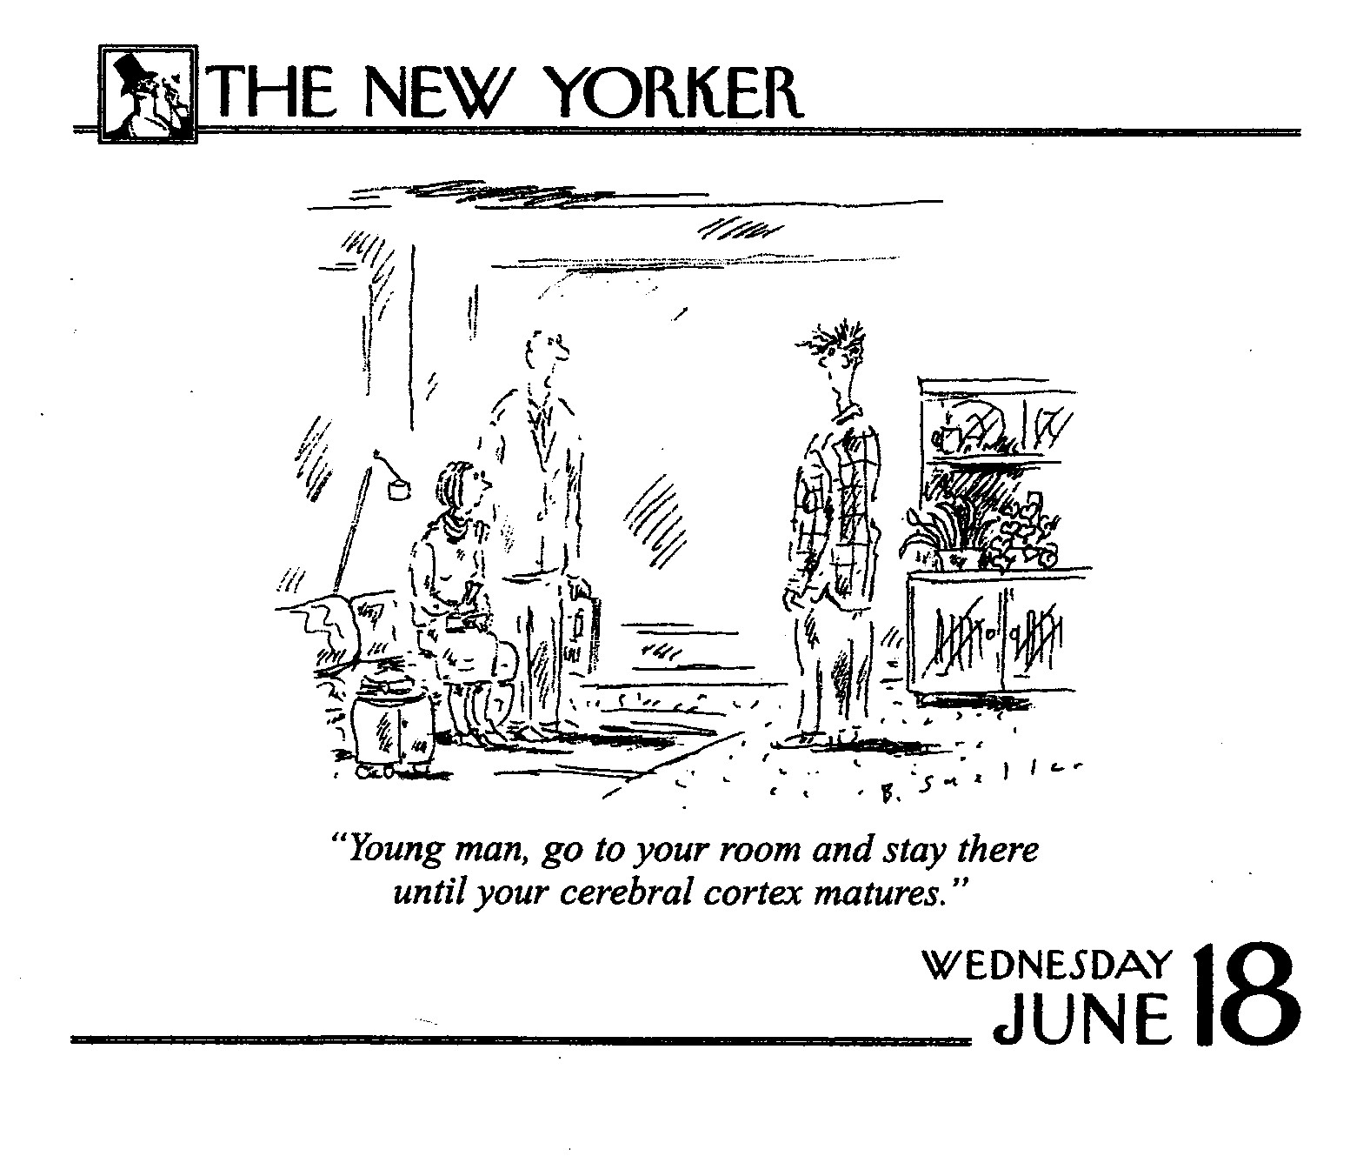

Slide 7
The Facts and Clinical Pearls Regarding Anxiety and Depression in Children and Adolescents

Slide 8


Slide 9
Normative Developmental Fears
INFANCY: Sudden loud noise, loss of support, strangers, separation
PRESCHOOL: Animals, the dark, monsters
SCHOOL AGE: Specific realistic fears, school acceptance and achievement
ADOLESCENTS: Fear of fear (the ability to think abstractly about fears)

Slide 10
What makes an Anxiety Disorder?
Persistent fear or worry
Leads to….
Marked distress or avoidance
Leads to….
Functional impairment (in learning, playing, socializing, family functioning)

Slide 11
Prevalence of Anxiety Disorders
Anxiety Disorders in children are as common as asthma ~ 14%
Kessler et al. Arch Gen Psychiatry. 1995;52:1048.
Kessler et al. Arch Gen Psychiatry. 1994;51:8.

Slide 12
Course of Pediatric Anxiety Disorders
Longitudinal Studies
  Cantwell et al. (1989) and Last et al. both found 80% children diagnosed (and treated) for an anxiety disorder (GAD, SP, SA) no longer had the disorder 4 years later, 70% were in remission in the first year
  Keller et al.(1992) Naturalistic Study (no treatment offered) 50% of children continued with anxiety disorders 8 years later

Slide 13
Clear Environmental Stresses for Children and Adolescents
Parents
  Parent child conflict
  Marital conflict
  Parental psychopathology
School
  Academic pressure
  The threat of violence (Bullying)
  Social stresses

Slide 14
Symptom Recognition: What To Look For
Physical complaints – headaches, stomach aches, dramatic presentations of pain.
Problems with falling asleep and middle of the night awakening, repeated visits to parents room
Eating problems
Avoidance of outside and interpersonal activities – school, parties, camp, sleepovers, safe strangers
Excessive need for reassurance – new situations, bedtime, school, storms, bad things happening
Inattention and poor performance at school
Not necessarily pervasive – some areas of function remain

Slide 15
Physical Symptoms – Provoked and Spontaneous
Anxious children listen to their bodies
Headache
Stomachache – stomach and bowel problems
Sick in the morning and can’t fall asleep in the evening
Frequent urge to urinate or defecate
Shortness of breath
Chest pain - tachycardia
Sensitive gag reflex - fear of choking or vomiting
Difficulty swallowing solid foods – growth inhibition?
Dizziness, lightheaded
Tension and tiredness – exhausted and irritable after a school day
Derealization and depersonalization
Avoidance to prevent above physical symptoms

Slide 16
Clinical Syndromes of Childhood Anxiety
Specific Phobias
Separation Anxiety Disorder
Social Phobia
  Selective Mutism
Panic Disorder
Generalized Anxiety Disorder
Obsessive Compulsive Disorder
Posttraumatic Stress Disorder

Slide 17




How to Recognize the
Moods of an Adolescent
HAPPY
DEPRESSED
EXCITED
ANXIOUS
MANIC
SUICIDAL

Slide 18
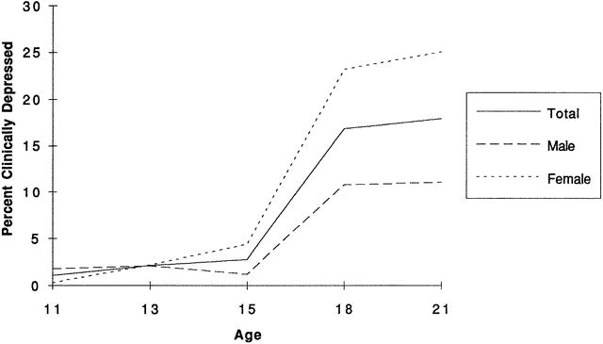
Adolescent Development
Development of overall rates of clinical depression (1-year point prevalence combining new cases and recurrences by age and gender)
(Hankin, et al., 1998)

Slide 19
Scope of the Problem
Mean length of episodes: 7 to 9 months
6% to 10% become protracted
Recurrence: 30 -50%
Associated with significant:
  comorbidity
  functional impairment
  risk for suicide
  substance use

Slide 20
Comorbidity of Depression and Anxiety Disorders
50% to 65% of panic disorder patients have depression†
70% of social anxiety
disorder patients have
depression**
Panic
Disorder
49% of social anxiety disorder patients have panic disorder**
HIGHLY COMMON…
HIGHLY COMORBID
Depression
Social Anxiety Disorder
11% of social anxiety disorder patients have OCD**
67% of OCD patients have depression*
OCD
* Rasmussen and Eisen. J Clin Psychiatry. 1992;53(suppl):4.
** Van Ameringen et al. J Affect Disord. 1991;21:93.
† American Psychiatric Association. Diagnostic and Statistical Manual of Mental Disorders, 4th ed. 1994.

Slide 21
Risk Factors for Anxiety and Depression
Genetic Predisposition
  Whose your mamma and daddy
Environmental Stresses
  How is your mamma and daddy
  How safe is home and school
  Academic and social pressures

Slide 22
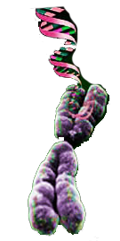
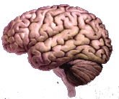
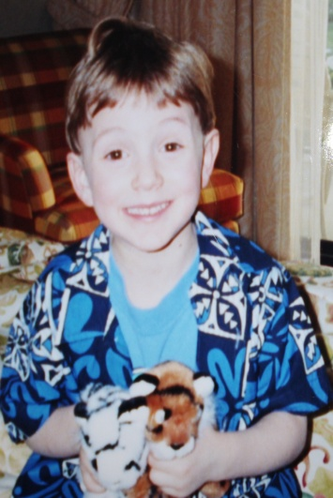
Stress Response Leading to the Development of Psychopathology
Environmental Stress
Hormone release
Epigenetic change
Changes in Brain Functioning
Changes in Behavior

Slide 23

Identical Twins Separated At Birth
Every cell in your body has the same nuclear genes, but…?

Slide 24
Some Of The Possible Causes Of The Increase In The Rates Of Depression And Anxiety In Children And Adolescents
Parental psychopathology
Early traumatic incidents
Changes in the extended and nuclear family
Effects of the Electronic Media
Changes in sleep patterns
Increased everyday stress

Slide 25
POVERTY
stressful life
events
PARENTAL
PSYCHOPA-
THOLOGY
PARENTING
child
development
IQ
absence of
social support
25
Notes:
25

Slide 26
The Effects of Parental Psychopathology on Brain Development and Behavior
If you help the parents you will be helping the child!

Slide 27
The Importance of Getting the Depressed Parent Treatment
Results of the STAR*D Child Study (3 month study)
  33% of children with anxiety and depression had symptoms resolved when moms depression resolved
  If moms depression didn’t resolve 17% of the children developed a disorder who didn’t have one at baseline over the 3 months

Slide 28
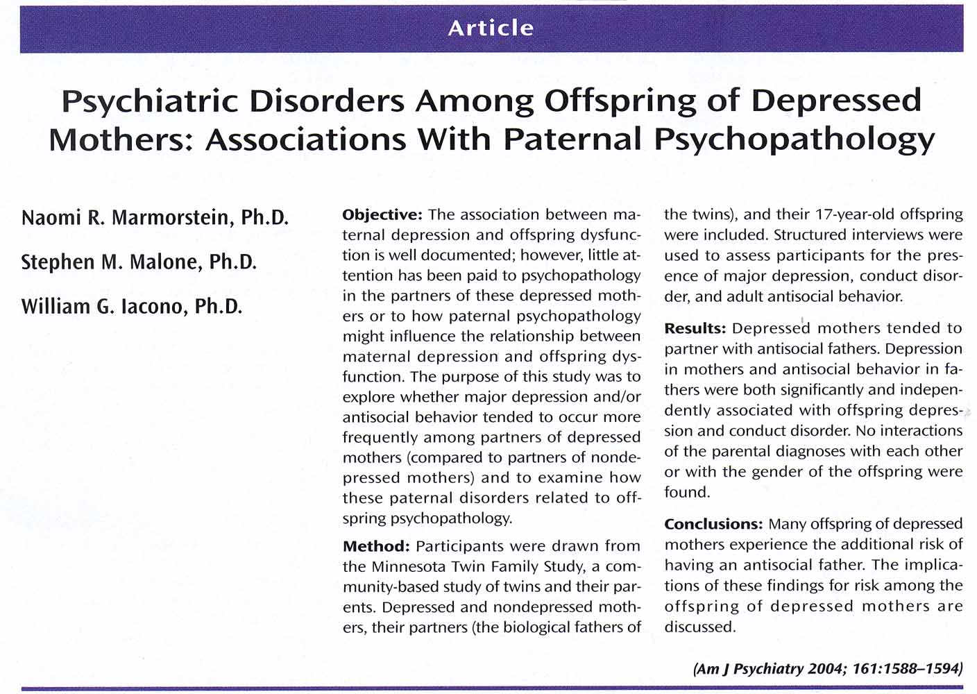

Slide 29
Effects of Early Psychological Trauma on the Development of Psychopathology
It depends on your genetic predisposition
Certain Genes protect us from the negative impacts of trauma and certain genes make us more vulnerable

Slide 30
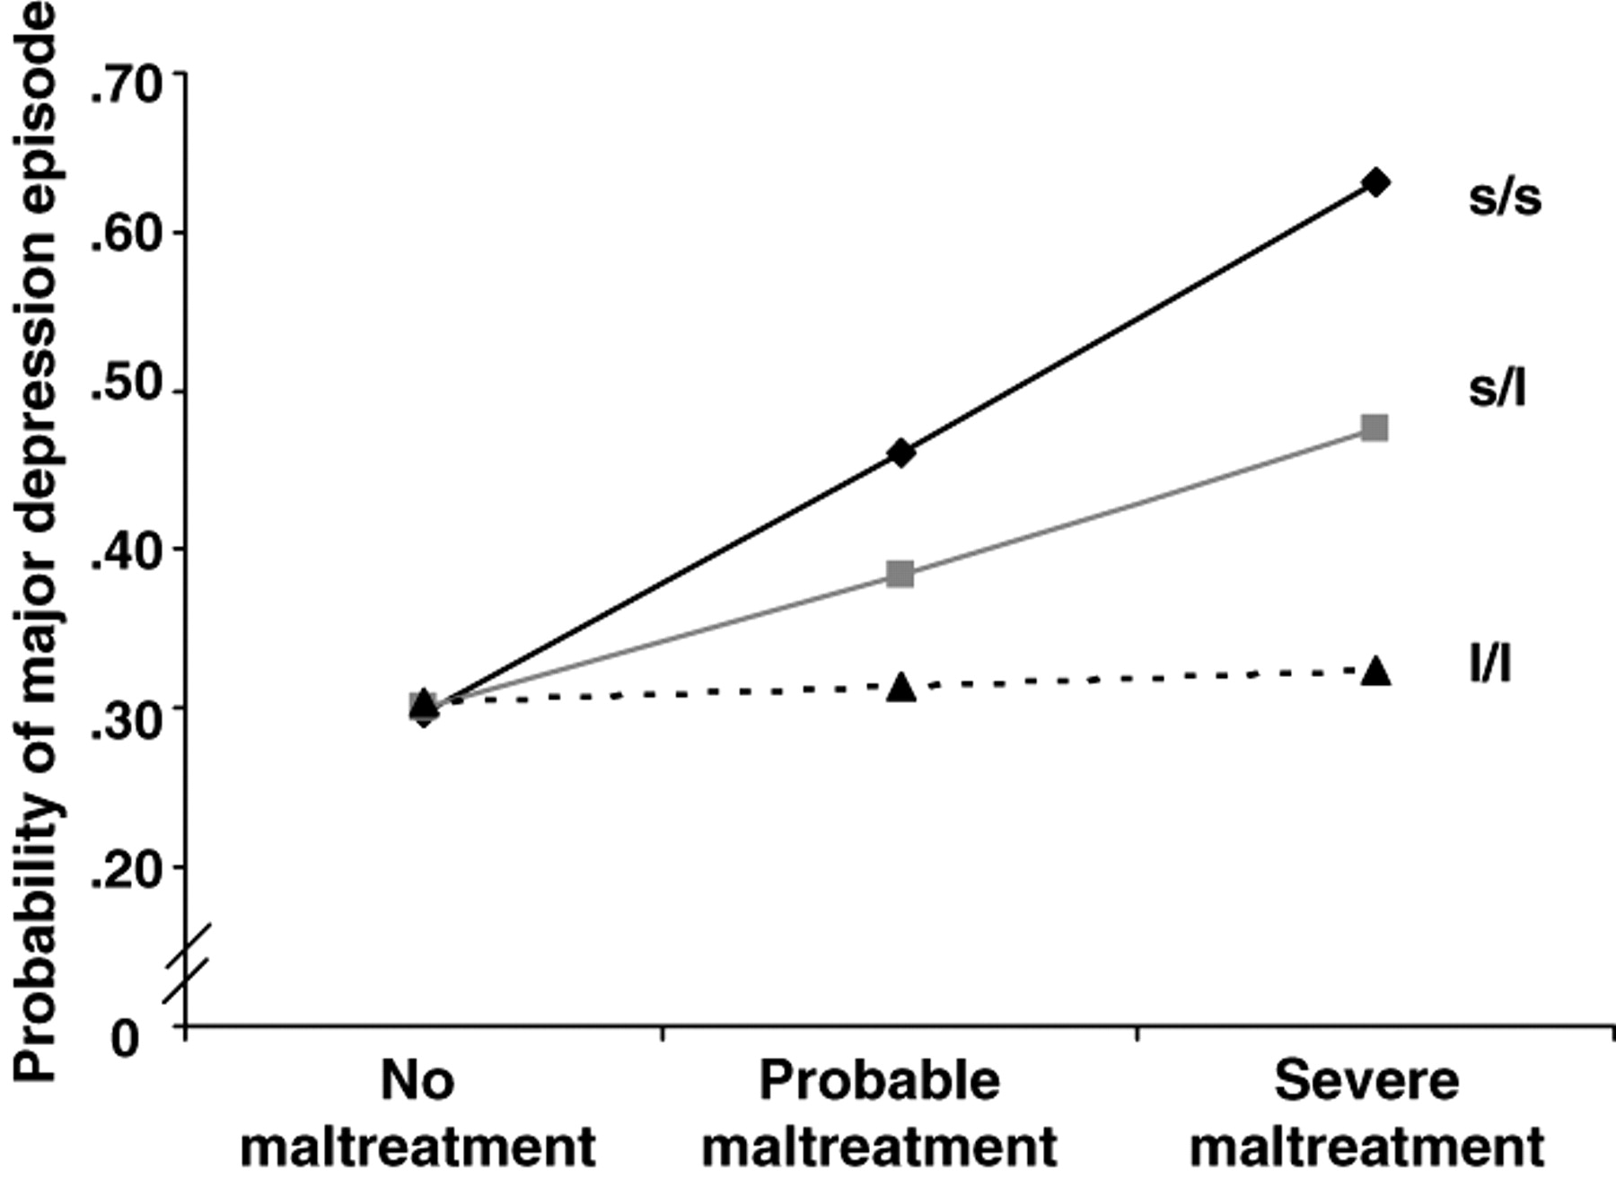
Gene-environment interaction and major depressive episode
Caspi, Science 2003

Slide 31
Developmental Origins of Adult Disease
Early experience
Abuse
Family strife
Emotional neglect
Harsh discipline
Health Risks
Depression
Drug abuse
Anxiety
Diabetes
Heart disease
Obesity
Mechanism?
Notes:
31

Slide 32
Cannabis use and Depression and Anxiety
Early initiation (Age 15) and frequent use (once a week) of cannabis resulted in higher rates of anxiety and depression, regardless of a history of mental illness. Hayatbakhsh, MR et al. 2007
Teens who smoke marijuana when feeling depressed are also more likely to become addicted to marijuana or other illicit drugs.

Slide 33
The Effects of Sleep on Cognition and Behavior
Need to discuss sleep hygiene with families
  Electronic age
  The culture of “ Sleepovers”
Youth who don’t get enough sleep are four times more likely to develop depression compared to peers who sleep more.
70 per cent of American high-school students fall well short of its recommended nine to 10 hours of sleep a night.
Data supporting later start to middle and high school

Slide 34
Effects of Electronic Media on our Kids
Dr Douglas Gentile et al,2009 in a study of some 3,000 eighth graders found video game addiction lead to poorer grades in school and serious psychological problems, including depression, anxiety, and social phobia.
7-11% of the gamers fulfilled criteria for addiction

Slide 35
The Impact of Television
What is the Exposure?
1950: 10% homes had TVs. 1996: 99%
2010 54% of kids had TVs in their rooms

Slide 36
Common Psychiatric Medications Used in Children and Adolescents

Slide 37
Serotonin Enhancing Agents, SSRIs & SNRI
  Waiting 4-6 weeks for full clinical response then reevaluating the dosage
  Choosing which SSRI to use
    Efficacy and tolerability in a parent or sibling. Looking at half lives and the P450 system

Slide 38
ONSET OF ACTION OF ANTIDEPRESSANTS
Synaptic Effects
(hours to days)
Side Effects
(hours to days)
Therapeutic Effects
(1 to 6 weeks)
0
2
4
6
8
Time after dosing with antidepressant (in weeks)
Richelson. Mayo Clin Proc. 1994
Stahl. Essential Psychopharmacology. 1996

Slide 39
In ADHD:
Stimulants Found to Improve
Core Symptoms
  Inattention
  Impulsivity
  Hyperactivity
Other Symptoms
  Noncompliance
  Impulsive aggression
  Social interactions
  Academic efficiency
  Academic accuracy
  Family dynamics
ADHD Practice Parameters. J Am Acad Child Adolesc Psychiatry. 1997;36:85S.
Greenhill LL, et al. J Am Acad Child Adolesc Psychiatry. 1999;38:503-512.
Notes:
Administration of stimulants to most patients with ADHD results in significant improvements in behavior
These improvements are observed in the core symptoms of inattention, hyperactivity, and impulsivity, which improves compliance, social interaction, academic efficiency, and accuracy

Slide 40
FDA Approved Treatments for ADHD
Methylphenidate-based formulations Duration of effect Adol/Adult
Concerta® | ~12 hours | +/+
Ritalin® | ~4 hours | –/–
Metadate® CD | 8–10 hours | –/–
Ritalin® LA | ~8 hours | –/–
Focalin® XR | 8–12 hours | +/+
Focalin® | ~5 hours | +/–
Daytrana® | ~12 hours (worn for 9) | –/–
Amphetamine-based formulations
Adderall XR® | ~12 hours | +/+
Adderall® | 4–6 hours | –/–
Dexedrine® Spansule | 6–8 hours | –/–
VyvanseTM | ~14 hours | –/–
Nonstimulants
Strattera Intuniv | Up to 24 hours 8-12 hour | +/+ +/-
Courtesy of TE Wilens, MD.
Notes:
This slide lists the stimulant formulations used in ADHD management, as well as the nonstimulants atomoxetine and Intuniv, which is approvable for children and adolescents. Some of these formulations are designed to provide clinical efficacy following once-daily dosing and have been devised to be more convenient and easy to use.

Slide 41
“Side Effects” With MPH and Amphetamine Therapy
Many “side effects” are characteristics of ADHD and
improve with stimulant treatment
5.0
Baseline
Dextroamphetamine
4.0
*†
*†
Methylphenidate
3.0
*
*
*†
Mean Severity
†
*
*
*
*
2.0
*
*
*
1.0
*
*
†
*
*
0.0
Trouble
sleeping
Poor
appetite
Irritable
Anxious-
ness
Day-
dreams
Biting
fingernails
Sadness
Tics
Headaches
Night-
mares
*P<0.01 vs placebo, †P<0.01 vs methylphenidate.
Efron D, et al. Pediatrics. 1997;100:662-669.

