Slide 1

Connecting Culture, Wellbeing & Employee Engagement for Organizational Success
Kathleen Schulz, ms, ches
Regional vice president, wellbeing & engagement practice leader – east
Notes:
Title Slide 1b
- Sneak peek at an alternate accent color

Slide 2
Top 5 Reasons Why Employees HATE Wellness Programs
My job is killing me
My manager doesn’t get it
The program isn’t fun
I’m concerned about my privacy
It feels more of a hassle than a help

Slide 3
Whatever you are thinking about wellness…

Slide 4
Wellbeing and Engagement has become a competitive advantage
Corporate adoption and growth is a priority
Change in C-Suite Attitudes
New data supports Engaged + Well employees = Greater productivity and retention = Greater Organizational Growth and Performance
Growing acknowledgment that Wellbeing and Engagement can only thrive with Executive leadership and support
Leadership
Culture
Employee Behavior
Business Outcomes

Slide 5

Wellbeing & Engagement
Our Philosophy. Business success is a function of the people you employ and how engaged they are with your organization.
Our Mission
We provide consulting expertise to help our clients develop broad, integrated strategies that help employees become more engaged and thrive at work, at home, and in their community.
Our Approach
Position wellbeing & engagement as a broad organizational solution that helps clients execute on their Employee Value Proposition and become an Employer of Choice.

Slide 6
What’s Hot?
Incentives
Unstable
workplace
Vendors
What’s it like to work here?
High Turnover
Manager Quality
Long hours
Onsite
Financial Wellness
Wearables
Low Engagement
Not paid fair

Slide 7
Connecting Career, Engagement, and Health Risks
BP
Obesity
Diabetes
Injury
Migraine
BP
Burnout
Depression
Long Hours
Injustice/ Fairness
Stress
Risk Heart Attack
i Opinion of your health
Work/
Family Conflict
Sleep Disorders
Sickness related absence
Risk Heart Attack
i Opinion of your health
Job Insecurity

Slide 8
The Evolution of “Wellbeing”
Then
Now
Multi-dimensional (employee and family) wellbeing with strong social networks
Employee value proposition, become an employer of choice
Right culture and environment
Inspire change, support, sense of purpose
Physical health emphasis
Benefits strategies for cost management
Right program and vendor
Participation incentives
Inconsistent alignment with mission/vision/values, desired culture, key business objectives
Wellbeing as a cultural imperative that drives engagement and enables high performance

Slide 9
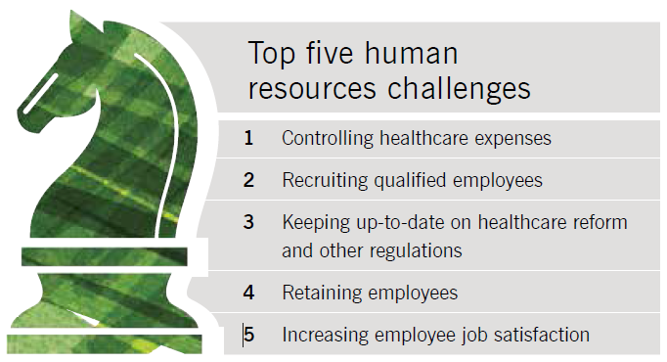
Thinking Bigger about Wellbeing & Engagement …
P
P
P
While healthcare costs remain the #1 challenge, Gaining an edge in the competition for talent ranks as a key priority for high-performing organizations that are looking to create an employer of choice environment.

Slide 10





The Multiple Dimensions of Wellbeing
Physical Health
Social/
Emotional Health
Financial Health
Career Health
Community Health
The WHOLE person comes to work every day....
each employee’s wellbeing influences
individual and organizational performance
&

Slide 11


The Evolution of Engagement
Pre-1990’s
1990’s
Late 1990’s -
Early 2000’s
Employee
Satisfaction
Employee Commitment
Employee Engagement
Satisfaction measures happiness and contentment.
Commitment includes satisfaction and also attachment to the organization.
Engagement
includes satisfaction, commitment plus energy and enthusiasm.

Slide 12
How do we define employee engagement?
engagement
noun | en·gage·ment \in-ˈgāj-mənt, en-\
a pronounced state of enthusiasm characterized by effort, pride and passion that fosters a mutually committed relationship between employees and their employers, resulting in the enduring pursuit of organizational and personal goals.
Notes:
While different employers define engagement in different ways, it is a robust multi-dimensional measure that taps employees’ emotional connectedness to their organization. The standard definition describes engagement as a pronounced state of enthusiasm characterized by effort, pride and passion that fosters a mutually committed relationship between employees and their employers, resulting in the enduring pursuit of organizational and personal goals. Defining engagement for the organization is the first step in developing a way to measure it and predicting its effect on business results.

Slide 13
Engagement data¹
202%
$11B
Organizations with engaged employees outperform those without them by up to 202%.
The amount lost annually due to employee turnover.
71%
of the US Workforce is not working to their potential…
1 Dale Carnegie Training, “The Importance of Employee Engagement” infographic, 2012
Notes:
Consider this data:
Organizations with engaged employees outperform those without them by up to 202%
71% of employees are not fully engaged
$11 billion is lost annually due to employee turnover

Slide 14
The Impact
Wellbeing and Employee Engagement are strongly linked
Engaged, thriving employees are more likely to…
Be agile and resilient
Have strong relationships and be active in their community
Be in control of their finances
Have fewer safety incidents
Report excellent performance
Stay with their employer
Have fewer health problems and lower healthcare costs
The
Opportunity…
Build a culture that supports the behaviors leading to a healthy and engaged workforce AND helps them execute on their EVP and become and Employer of Choice

Slide 15
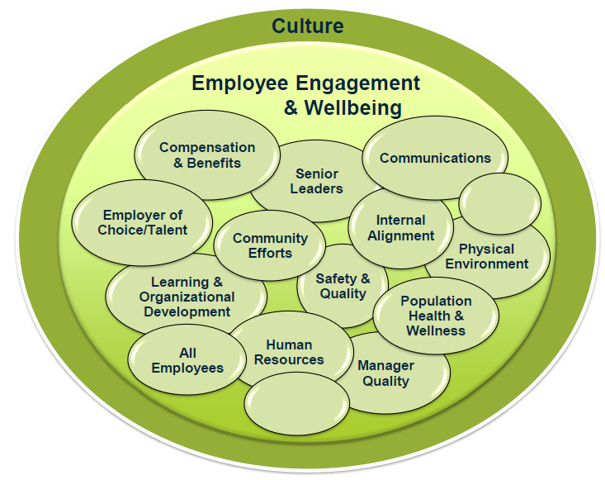
What’s Your EVP?
Business success is a function of the people you employ and how engaged they are with your organization.
Does your benefits strategy reflect your workforce (and what they value)…
today?
tomorrow?
next year?

Slide 16

Connecting the dots…

Slide 17
What’s your culture?
Culture noun | cul·ture \ ˈkəl-chər\
Definition - The character and personality of your organization. It's what makes your organization unique and is the sum of its values, traditions, beliefs, interactions, behaviors, and attitudes.
Employee
Health
Learning & Development
Inclusion
Innovation
Safety
Performance
Every business decision begins with the question…
“how will this impact our employees?”

Slide 18
Culture and participation…
Who is most likely to motivate you to improve your health?
1. Colleagues
2. Spouses/Partners
3. Friends
4. Children

Slide 19
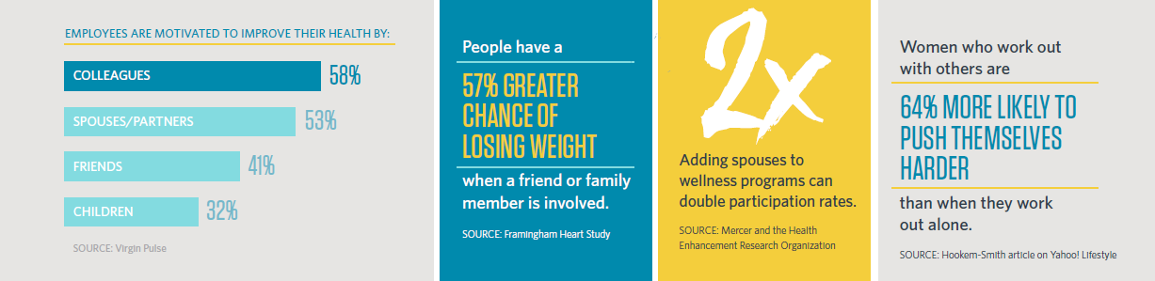
Culture drives behavior…

Slide 20
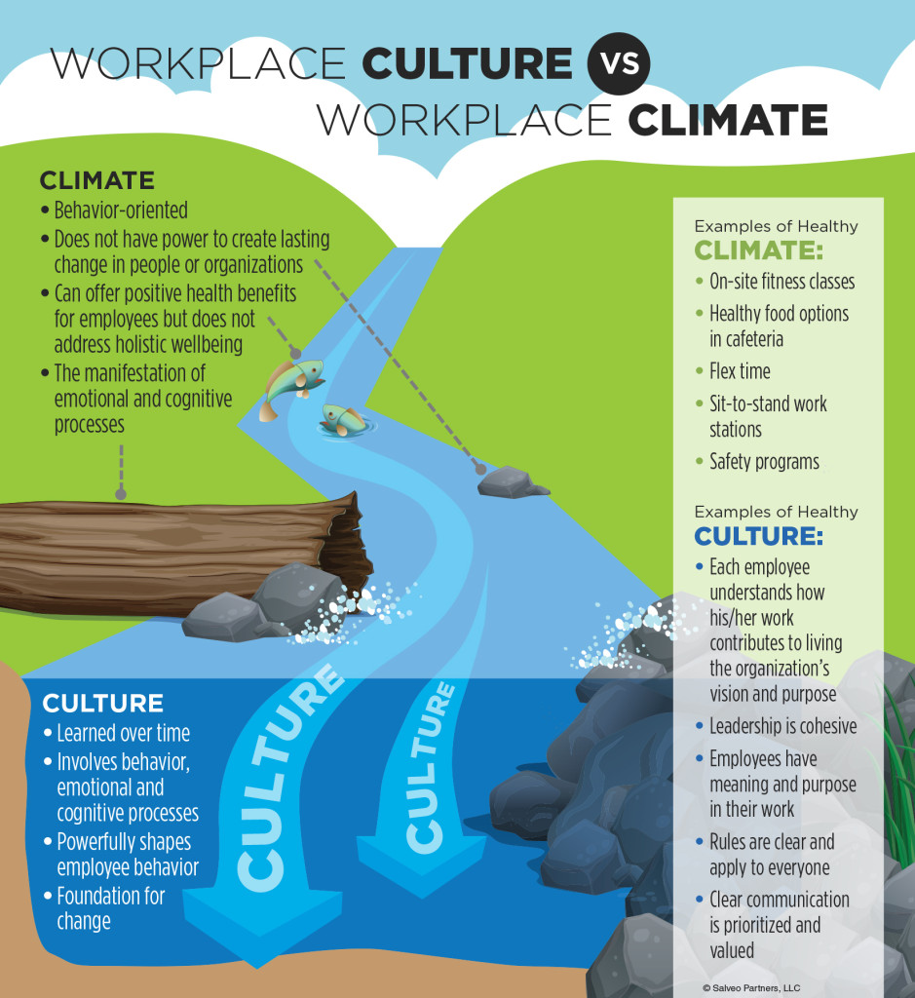
What’s Culture Got to do with it?
What high performing organizations know about culture…
Behavior is highly influenced by culture, environment (climate) and social norms.
When culture and climate align… employees thrive
20

Slide 21
What happens when culture, mission, and EVP don’t align?
One employers value statement
Respect
Integrity
Excellence
Comms
“We treat others as we would like to be treated ourselves. We do not tolerate abusive or disrespectful treatment. Ruthlessness, callousness, and arrogance don't belong here”.
"We are satisfied with nothing less than the very best in everything we do.”
“We work with customers and prospects openly, honestly, and sincerely”.
“The great fun here will be for all of us to discover just how good we can really be”.

Slide 22


What happens when culture, mission, and EVP don’t align?
Enron had these values displayed
in their lobby:
Respect
Integrity
Excellence
Communication

Slide 23


What happens when culture and wellness strategy don’t align?
Health Plan Penalty Ends at Penn State
SEPT. 18, 2013
After weeks of vociferous objections by faculty members, Pennsylvania State University said on Wednesday it was suspending part of a new employee wellness program that some professors had criticized as coercive and financially punitive…

Slide 24

Our Framework

Slide 25

65 - 70%
of an individual’s overall health status is determined by individual lifestyle behaviors
Step 1: It’s All About Culture
Behavior is highly influenced by culture, environment and social norms.
Leadership
Culture
Employee Behavior
Business Outcomes

Slide 26

Step 2: Analyze Your Workforce
Creating a framework that enables employees to grow with your organization is important to employee engagement, loyalty and wellbeing.
Employees want and value different benefits at different career stages
Entry Level
Mid-Career
Career Growth
Income
Fitness
Recognition
Volunteerism
Financial Stability
Income & advancement
Time off/flexibility
Health & Fitness
Financial Stability
Established
Pre-Retiree
Time off/flexibility
Health & Wellbeing
Leadership
Mentoring Opportunities
Financial Stability
Health & Wellbeing
Career accomplishment
Preparing to transition to retirement
Financial Stability

Slide 27
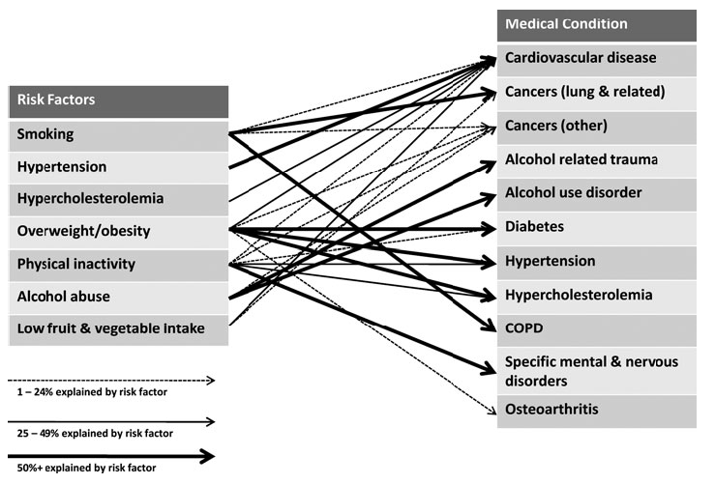
Step 3: Understand Your Risk
{
Lifestyle Risks
ask your employees
Source: Bolnick, H., Millard, F., and Dugas, J., Medical Care Savings from Workplace Wellness Programs, JOEM 2012, Jan, 55(1): 4-9.

Slide 28

Step 4: Build Your Plan
Wellbeing & Engagement Strategy Framework
Health Benefits (Design, financing, risk management, and administration) | Wellbeing & Engagement (Optimization of workforce productivity through engagement and good health)
Understand Culture, People, Risk
Connect Wellbeing Vision to Business Strategy & Objectives
Capture CEO Support
Essential to process and best in class program
Develop Strategic Plan
Build operating plan to serve as roadmap and guide interventions
Find Partners
Conduct market survey for wellness partner, if appropriate
Develop Communications Create pervasive communications that execute on broad wellbeing & engagement goals
Build Internal Alignment
Develop guiding principles, goals, objectives & success metrics
Create Wellbeing Team
Build cross functional Team to drive wellbeing awareness and distribute accountability throughout organization
Collect Data
Gather data to reveal specific areas of health/engagement needs and interests within the organization
Evaluate
Beyond traditional metrics on participation, risk reduction, and cost containment, identify organizational metrics (retention, safety, engagement, etc.)

Slide 29
Thank You!

