Slide 1
Designing & Delivering Whole-Person Transitional Care
Amy E. Boutwell, MD, MPP
9th Annual AHI Summit
September 21, 2017

Slide 2
Agenda
This is possible!
Key steps to design an effective strategy
Key practices to deliver effective care
Examples from small and rural hospitals

Slide 3
Objectives for this Session
Understand the effectiveness of redesigning care based on:
  An understanding of data and root causes
  Effectively engaging patients and care partners
  Addressing whole-person needs, and
  Actively collaborating across the continuum

Slide 4
Who do you consider at risk of readmission?

Slide 5
Medicare Readmission Penalty Created Focus - also Blinders
Diagnosis-based focus
Medicare focus
Limited our understanding of who is at risk of readmission
Narrow “project-itis” limits system redesign – hard to break through to transforming care

Slide 6
AHRQ Reducing Medicaid Readmissions Project
Identify the similarities & differences in readmission patterns for Medicare v. Medicaid patients
Explore whether the models developed for older adults apply to the Medicaid population as well
Create a guide for hospitals to expand and adapt strategies to reduce readmissions – to apply to a broader, all payer population

Slide 7
Hospitals with Hospital-Wide Results
Know their data –
  Analyze, trend, track, display, share, post
Broad concept of “readmission risk”
  Way beyond case finding for diagnoses
Multifaceted strategy
  Improve standard care, collaborate across settings, enhanced care
Use technology to make this better, quicker, automated
  Automated notifications, implementation tracking, dashboards

Slide 8


Designing and Delivering Whole-Person Transitional Care:
The ASPIRE Guide
13 customizable tools
6-part webinar series

Slide 9
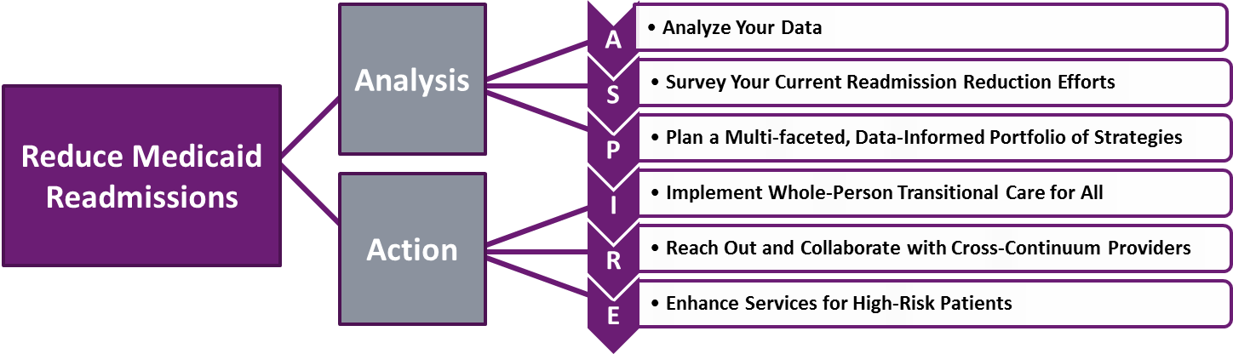
ASPIRE Framework
“Design”
“Deliver”

Slide 10
All Cause, All Payer 30-day Readmissions
ASPIRE Field Work Hospitals

Slide 11
Know your (own) Data
Success everywhere – and especially in rural communities – is customized

Slide 12
Readmissions by Payer
Statewide Pattern
Example Hospital A
Example Hospital B
Source: Boutwell in collaboration with the Massachusetts Center for Health Information and Analysis 2016

Slide 13
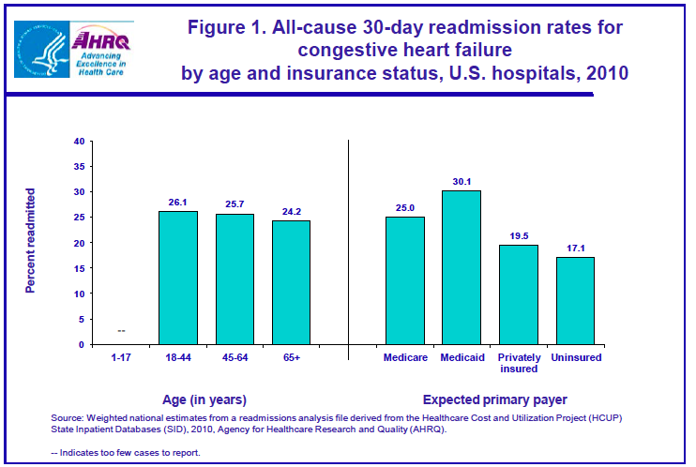
Readmissions by Age
Example Hospital A
Are you targeting adults <65?
Example Hospital B
Source: Boutwell in collaboration with the Massachusetts Center for Health Information and Analysis 2016

Slide 14
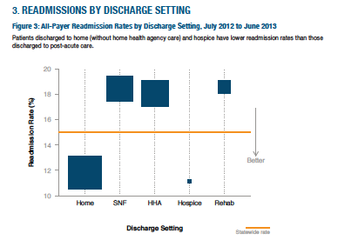
Readmissions by Discharge Disposition
Example Hospital A
Are you targeting Home Health discharges?
Readmission rates among all patients discharged to post-acute care are high
Source: Boutwell in collaboration with the Massachusetts Center for Health Information and Analysis 2016

Slide 15
Timing of Readmissions
Example Hospital A
Example Hospital B
Are you focused on early readmissions?
Source: Boutwell in collaboration with the Massachusetts Center for Health Information and Analysis 2016

Slide 16
Discharge Diagnoses Leading to Most Readmissions
Medicare | Medicaid | Comm. | Unins. | Total
ARF (1384) | Sickle Cell (478) | Chemo (290) | Pancreatitis (187) | Sepsis (1859)
Sepsis (1366) | Sepsis (175) | CVA (276) | Chemo (157) | ARF (1800)
PNA (1336) | Chemo (175) | Arthritis (260) | DKA (136) | PNA (1750)
COPD (1211) | COPD (173) | Sepsis (222) | CVA (125) | CVA (1622)
CVA (1140) | DKA (156) | PNA (188) | COPD (109) | COPD (1608)
UTI (1038) | PNA (145) | ARF (182) | ARF (97) | UTI (1608)
Afib (851) | ARF (137) | CAD (181) | Sepsis (96) | HF (1115)
HF (822) | HF (129) | Pancreatitis (153) | PNA (81) | CAD (1092)
CAD (746) | Pancreatitis (127) | Afib (152) | ETOH w/d (76) | Afib (1092)
Source: Boutwell in collaboration with South Carolina Hospital Association
Source: Boutwell in collaboration with the Massachusetts Center for Health Information and Analysis 2016

Slide 17
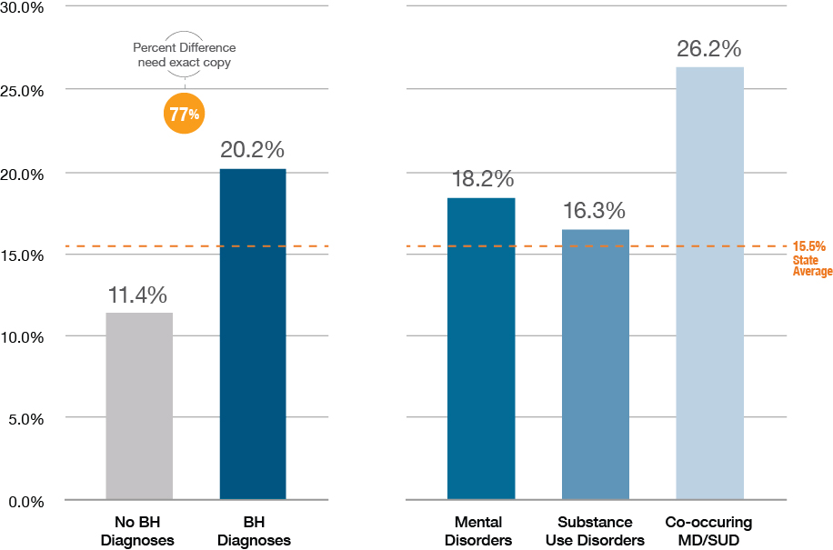
Readmission Rates for People with BH conditions
40% of adult hospitalized patients had at least 1 behavioral health condition
Patients with a BH condition had 77% higher readmission rates
Source: Boutwell in collaboration with the Massachusetts Center for Health Information and Analysis 2016

Slide 18
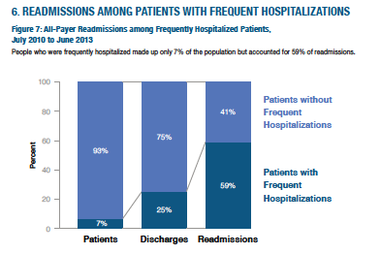
Readmissions for Multi-Visit Patients
4+ hospitalizations/year
7% - 25%- 60%
Hospitalizations: 6 v. 1.3
LOS: 6.1 days v. 4.5
Readmission rate 38% v. 8%
Boutwell with Massachusetts Center for Health Information and Analysis 2016
Jiang et al. AHRQ HCUP Statistical Brief #184 Nov 2014

Slide 19
Ask your patients “Why”
Elicit the story behind the chief complaint; identify root causes

Slide 20
Understand the “story behind the chief complaint”
86M with cancer hospitalized for abdominal pain returns to the hospital 1 day after discharge with pain.
77F discharged following sepsis returns to the hospital 8 days later with shortness of breath.
61M with 8 hospitalizations this year for shortness of breath returns to the hospital 10 days after discharge with shortness of breath.
Chart reviews and administrative analyses will NOT reveal what you need to know: you must talk to your patients, their families, care partners, providers

Slide 21

Interviewed 60 patients who returned to ED <9days of visit
    Average age 43 (19-75)
    Majority had a PCP,
    Preferred the ED: more tests, quicker answers, ED more likely to treat symptoms
    Most reported no problem filling medications
    19//60 thought they didn’t get prescribed the medications they needed (pain)
    24/60 expressed concerns about clinical evaluation and diagnosis
Primary reason: fear and uncertainty about their condition
Patients need more reassurance during and after episodes of care
Patients need access to advice between visits
Annals of Emergency Medicine

Slide 22
Improve standard transitional care for all
Identify and address post-hospital needs; link, don’t refer

Slide 23
Risk Score v. Risk Screen
Readmission Risk Score:
    “Does this patient have a high readmission risk score?”
    If so, we do something different for them….
    Readmission Risk Screen:
        “Does this patient have needs that could lead to a readmission?
        If we find a risk (or need), we address that risk (need)

Slide 24
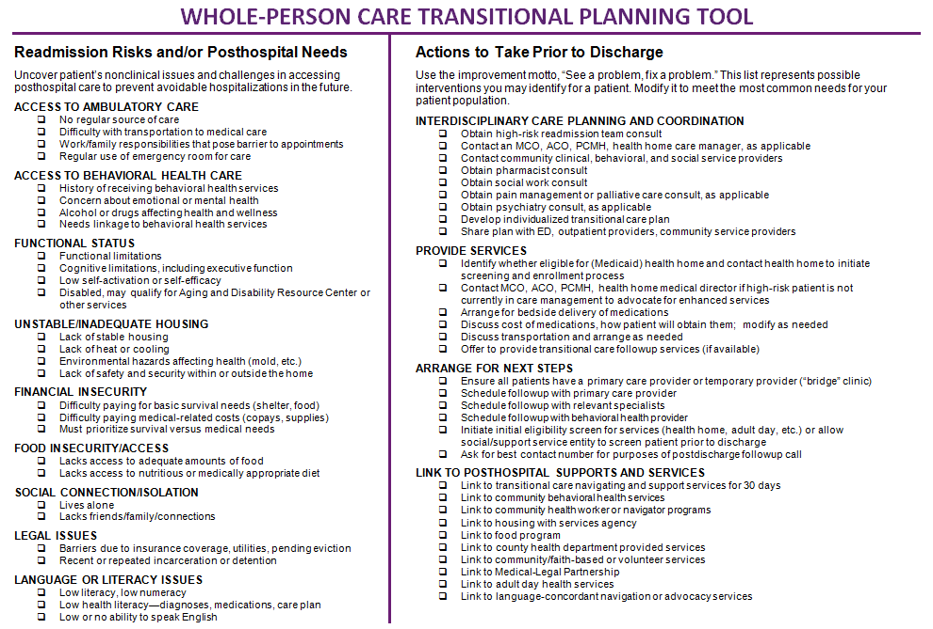
Readmission Risk Screening Tools
9th “P” = poverty
10th “P” = patient preference

Slide 25
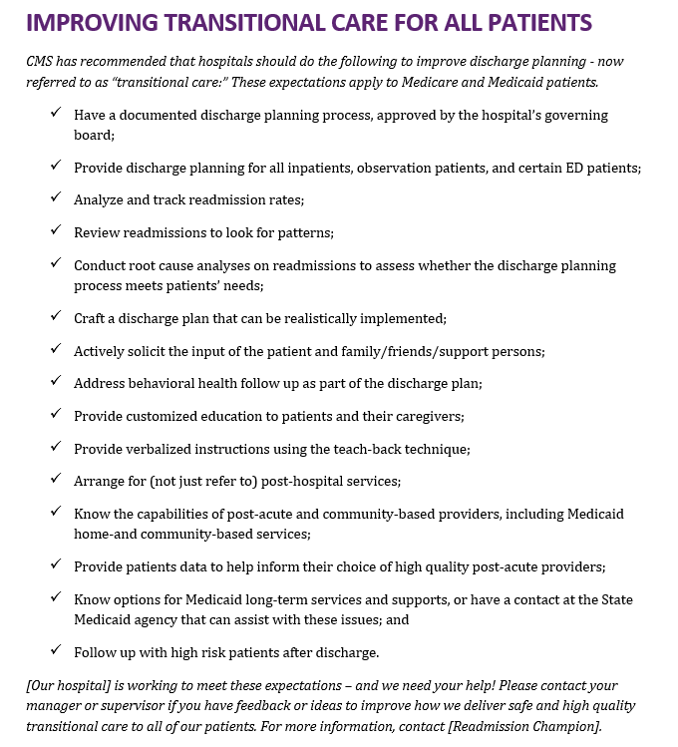
Improve Standard Care for All
Identify all patients at high-risk of readmission
Assess patients for clinical, behavioral and social needs
Communicate with patients simply and effectively
Link patients to follow-up and post-hospital services
Provide real-time information to receiving providers
Ensure timely post-discharge contact
AND
Have a process
Track, trend and review readmissions
Continuously improve the process to meet needs
ASPIRE Tool 8
https://www.ahrq.gov/professionals/systems/hospital/medicaidreadmitguide/index.html

Slide 26
Collaborate Across settings
Not just a handoff; a purposeful, measured, managed collaboration

Slide 27
“You don’t understand, there are just no resources in the community”

Slide 28
“We would be thrilled if someone from the hospital called us”

Slide 29
Collaborate with “Receivers”
SNF
Visiting Nurse Agencies
Patient Centered Medical Homes
Adult Day Care Centers
Behavioral Health Centers
Medicaid Managed Care Plans
Health Homes
Group Homes
Housing Authority
Transportation Providers
County Health Departments
Food Assistance
Legal Advocacy Assistance
Peer Support
“We would be thrilled if someone from the hospital called us”

Slide 30
New Frontier of Collaboration: the ED
Create a 30-day return flag on the ED Tracker Board
Use the 30-day return flag to notify the high risk care team
Use ED care alerts to inform treating providers; connect with care team
Develop “treat and return” pathways
“In previous times, the path would’ve been to simply admit the patient, and we’ll sort it out later. We’re becoming more accustomed to working in ER to help discharge patients from the ED. That’s a culture change.”

Slide 31
Take a “whole-person” approach
Engagement, responsiveness, helpfulness are patient-centered

Slide 32
“Whole-Person” Adaptations to Transitional Care
Navigating
Hand-holding
Arranging for….
Providing with….
Harm reduction
Meet “where they are”
Patient/caregiver priorities first
Relationship-based

Slide 33
Whole-Person Approach
Successful readmission reduction teams state:
  “We look at the whole person, the big picture”
  “We always address goals and ask what the patient wants”
  “We meet the patient where they are”
  “First and foremost it’s about a trusting relationship”
  “You can’t talk to someone about their medications if there is no food in the fridge”
  “Our navigators are flexible, proactive, and persistent; they address all needs. Each of them has incredible interpersonal skills”
  “We do whatever it takes”

Slide 34
Engagement = Outcomes
The best plans can not work if they are not delivered

Slide 35
Engagement → Implementation →Outcomes
Use focus on engagement to drive outcomes
What matters is whether the service was delivered, not whether it was offered
Low levels of “consent” or “engagement” signal need to change our approach
Breakthroughs: be personable, low-barrier, be helpful, navigate, link
Effective engagement is a marker for good outcomes; it is a virtuous cycle

Slide 36
Percent of Target Population Patients Served
Key lessons:
Reliably identify target pop
Face to face in-hospital
Opt-out approach
Continuation of your care
Avoid “special program”

Slide 37
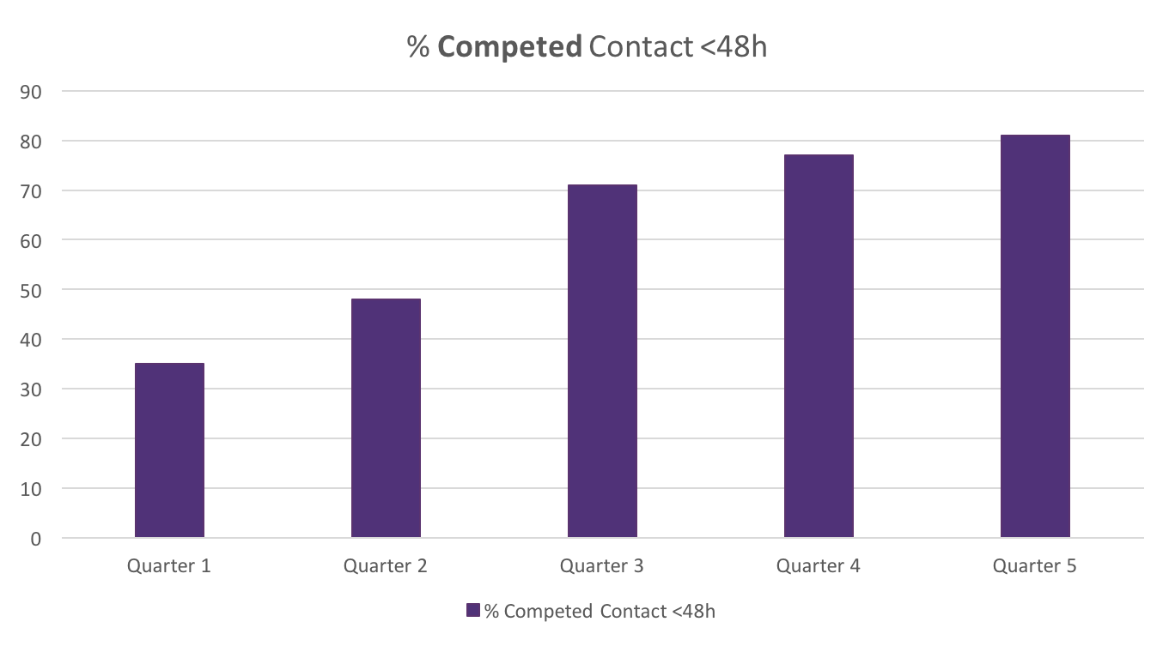
Timely Contact Post-Discharge
Key lessons:
“It’s my job to check on you once you go home”
Use texting
Any relevant contact
Call their cell prior to discharge to confirm #

Slide 38
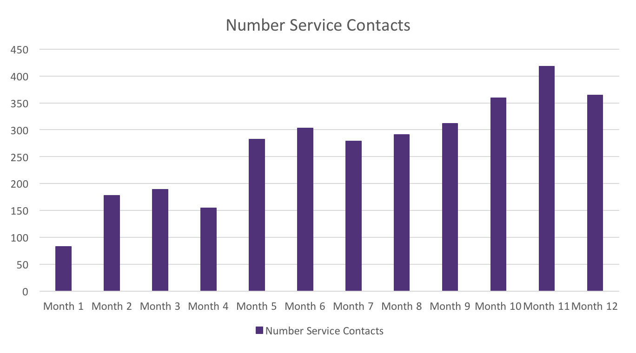
Intensive Service Delivery: Work Smarter
Key lessons:
Brief in-hospital visit
Prioritize community visits
Batch SNF visits
Batch home visits
Batch documentation

Slide 39
All Cause All Payer 30-day Readmissions
ASPIRE Implementation Hospital

Slide 40
This is possible
Examples from small and rural hospitals

Slide 41
Rural Hospital: All Payer Heart Failure
ED CM flags all HF admits
List to HF ToC RN
1-2 new patients / day
Brief visit in-hospital
Phone calls x 30 days
Transportation
Medication – affordability
Care seeking patterns
Team:
ED CM, 1 RN
Finance/ Quality Analyst

Slide 42
Rural Hospital: High Risk Readmission
Daily review of inpatient census
High risk: any cardiac, pulmonary or behavioral health condition
~50% of inpatients “high risk”
Only 4-6 people per day
Brief meet & greet in-hospital
48h follow up call
Home visit “just to see if we can help with anything you might need”
SW and RN did visit together
Identified needs, mobilized services
Team:
1 RN, 1 SW

Slide 43
Rural Hospital: Frequent Users of the ED
Identify
Engage
Be helpful
Problem solving
Navigating
“Life skills”
Coping
Different response
Team:
“Air traffic controller” – notifies team
1 SW, 2 CHWs
Director of Care Management / Discharge Planning/ Quality

Slide 44
Summary
Use a data-informed approach to designing efforts
Design efforts targeted at root causes of readmissions
Prioritize effective engagement
Address whole-person needs
Actively collaborate: this is a team sport
Deliver interventions: change what we do until we are effective

Slide 45
Thank you for your commitment to improving care
Amy E. Boutwell, MD, MPP
President, Collaborative Healthcare Strategies
Co-Principal Investigator, AHRQ Designing and Delivering Whole-Person Transitional Care
Amy@CollaborativeHealthcareStrategies.com

