Slide 1
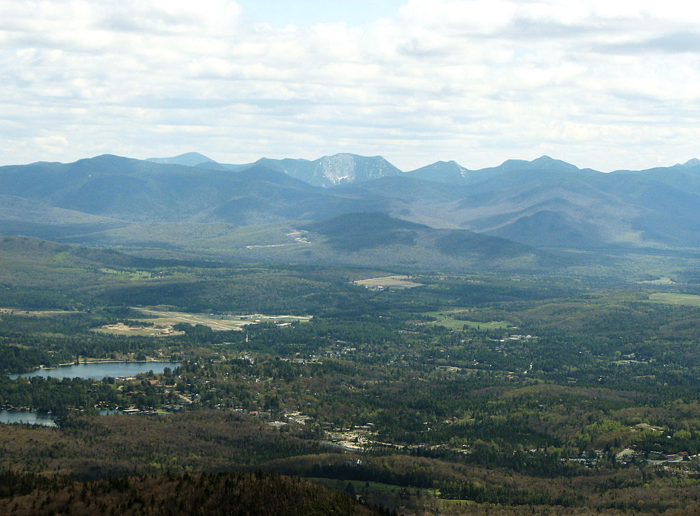
AHI 9th Annual Summit
Lake Placid, NY
September 21, 2017
Leading the Movement for Health Equity

Slide 2

The Institute’s Programs
Family, Youth, Professional Development
Leadership
Development
Financial
Planning & Mgt.
Gender
Specific
Health &
Wellness
Workforce
Development
PSALMS
ROPES/
Mentoring
Music & Arts
Academy
Oratorical/
Public Spkg.
Racial
Healing

Slide 3

If you’re a leader, you’re leading people somewhere else – somewhere that’s not here. That’s the job.
If the group is staying in the same place, they may need a manager, but not a leader.
The Work of Leaders; Julie Straw, Mark Scullard, Susie Kukkonen, Barry Davis

Slide 4
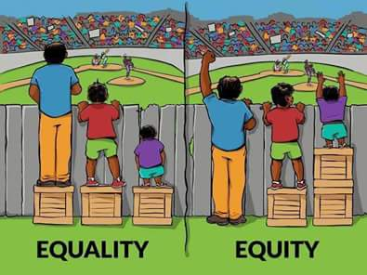
What Should Health Equity Look Like?
Sameness
Fairness

Slide 5
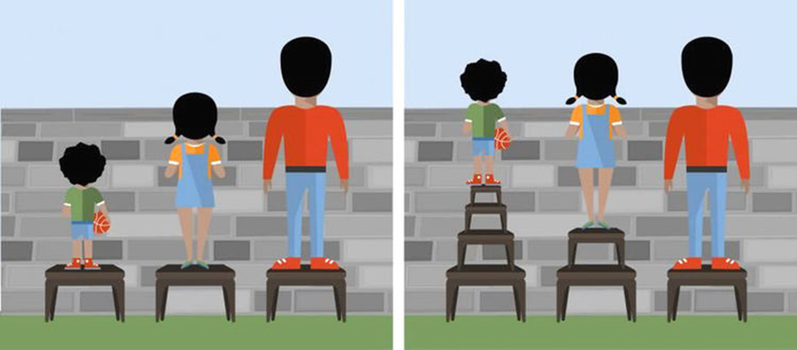
Some Prefer This Picture. Any Idea Why?

Slide 6
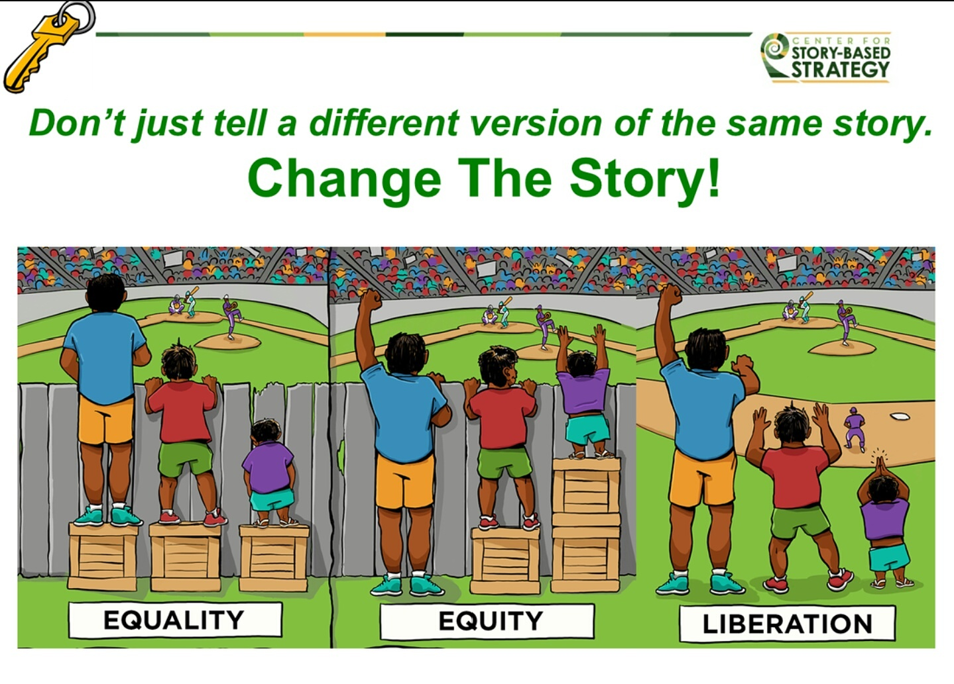

Slide 7
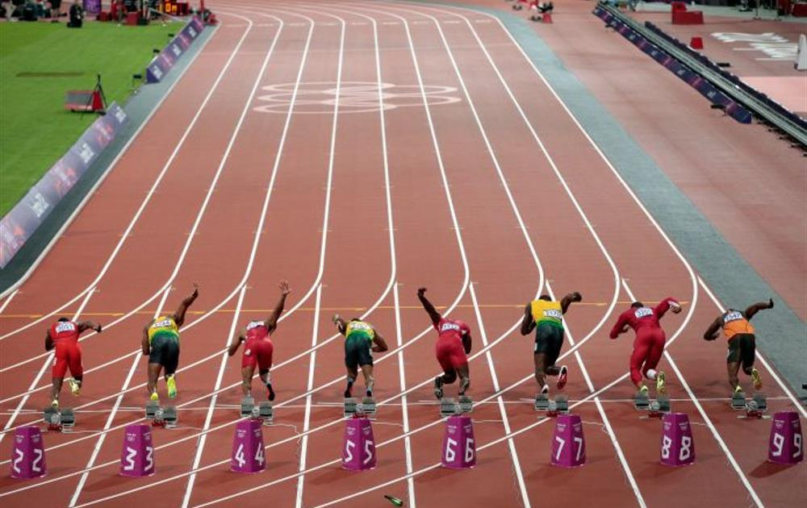
All Things Being Equal!

Slide 8

Equity!

Slide 9

Leadership work
Thinking long-term
Looking beyond your unit, grasping the relationships to others
Reaching and influencing constituents
Putting emphasis on vision or values
Management Work
Focusing on production and process, monitoring quality and quantity
Technical Work
Doing the actual work, performing the task, hands on
Notes:
Get and give examples of the 3 kinds of leadership work. Discuss how its possible and necessary sometimes to change management and technical work to leadership work, and give examples of how this can be done.

Slide 10
Winning Organizations & Movements…
Have strong values
Everyone knows the values
Everyone knows what they look like
Decisions are made that are consistent with the values
The organization finds ways to energize it’s members
Edge decisions are made & people can see when & where the tough calls are
Notes:
Make note of Enron’s values statement in annual report.

Slide 11
Outdated Leadership Model
CEO/Boss
Executive Staff
Managers
Workers

Slide 12
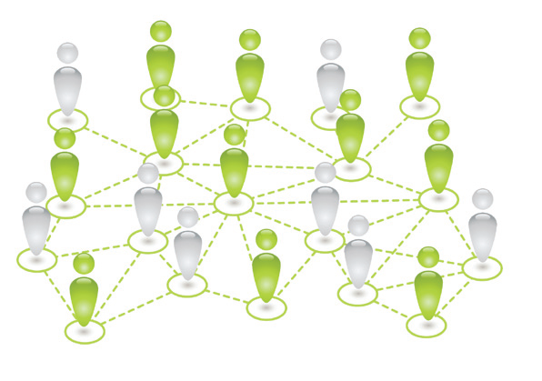

Traditional Leadership Mindset
New Collective Leadership Mindset
Notes:
From Leadership for a new era, The Leadership Learning Community. This work is licensed under the Creative Commons Attribution 3.0 License.
This license allows the copying, distribution, and display of this work—and the ability to adapt the work—if credit is given to the authors. Additionally, please link to the following website: http://www.leadershipforanewera.org.

Slide 13
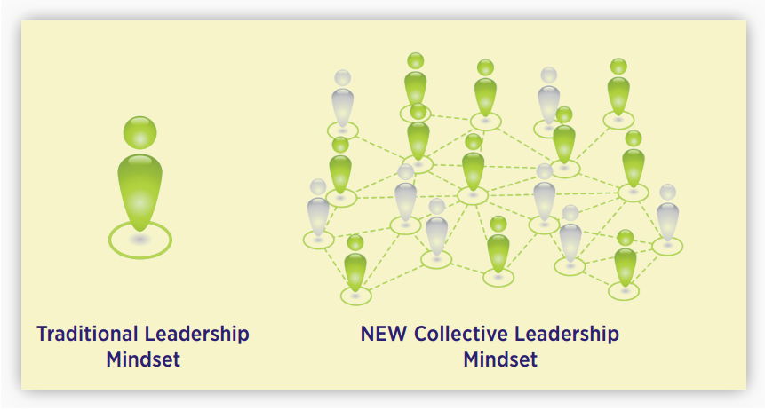
Who Is In Your Health Equity Network?
Who Is Missing?
Why?

Slide 14
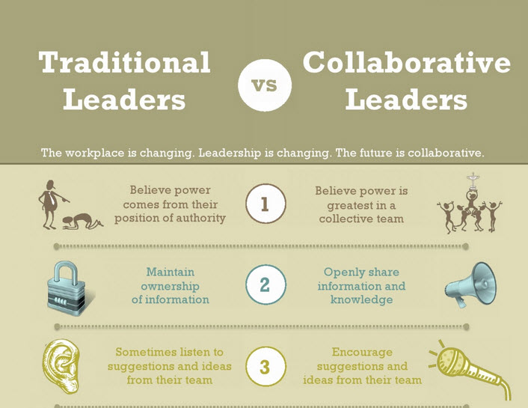

Slide 15
A network is a set of relationships that are characterized by both strong and weak ties. Strong ties are characterized by high levels of trust, reciprocity, and sense of community, whereas weak ties cross boundaries and are a source of new ideas, information, and resources.
Network mindset is a term used to describe the patterns of thought that enable us to become aware of how what we say and do connects with others and creates ripples through an ecosystem.
Collective leadership is the process of many people working together and aligning their efforts to achieve greater impact on significant social issues.

Slide 16
Case Example: KaBOOM!
The national nonprofit KaBOOM! (kaboom.org) aspires to create a “great place to play within walking distance of every child.” To bring their idea to scale, they used a network strategy: they posted an online “do-it-yourself” direction kit making it possible for more communities to access the resources needed to build playgrounds without direct support from KaBOOM! The founder of KaBOOM! Understood that if he shared leadership in the production of playgrounds by decentralizing planning and letting people run with a design template, more children would have playgrounds. To realize KaBOOM!’s vision, “the leader” became one of many leaders doing the work and bringing their own unique spin to the projects. This shift in strategy (and control) empowered communities to build 1,600 playgrounds in one year, more than KaBOOM! had built in the previous 14 years of its existence.

Slide 17
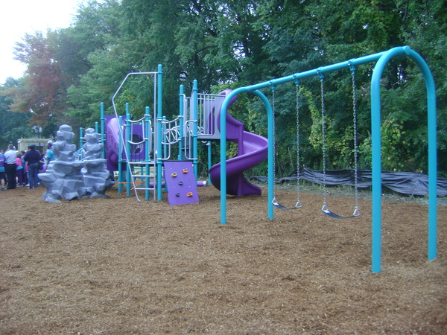
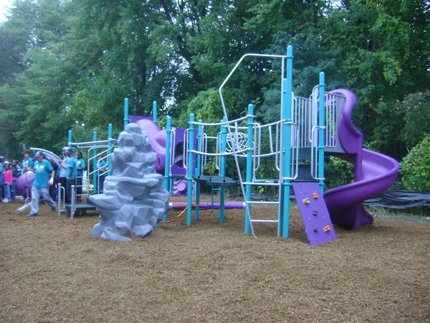
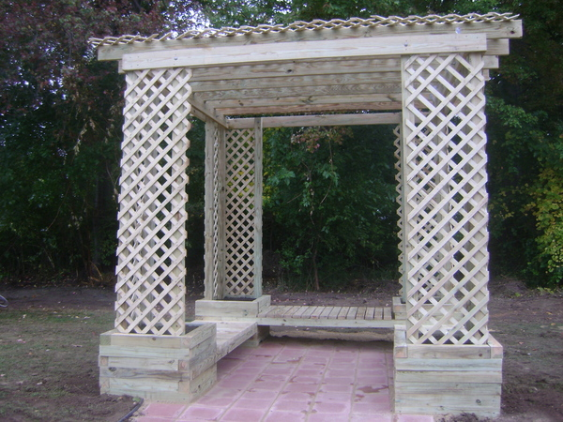

Slide 18
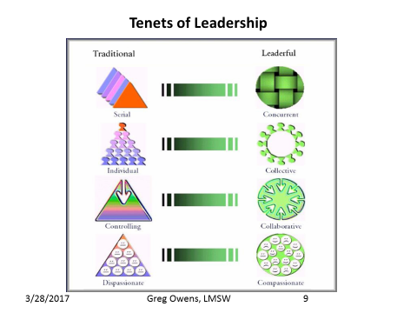

Slide 19
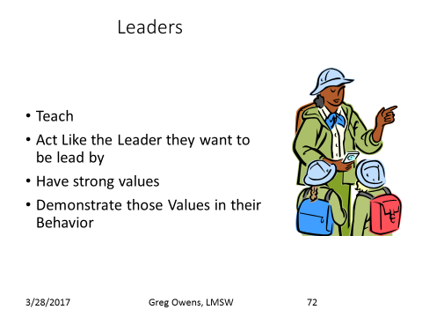

Slide 20
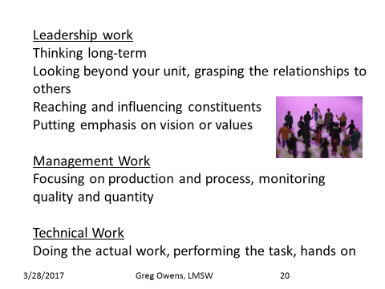

Slide 21
Think of a Typical Week
What did you do when you woke up?
What did you think about on the way to work?
What was the first thing you did when you arrived at work?
What did you do during the rest of the morning?
What did you do during lunch? Did you eat alone or with a colleague?
What did you do from lunch until the end of the day?
What did you think about on the way home?
What did you do when you got home?
What about before you went to bed?

Slide 22
List the activities by whether they were Technical (T), Management (M) or Leadership (L)
Think of one activity from the management or technical columns and brainstorm how you might convert that to a leadership activity.

Slide 23
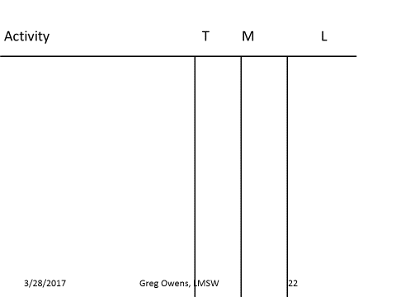

Slide 24
Lower Performance Organizations
Management Philosophy and Style
Problem Driven
Rule-bound; system focused
Centralized control of information, resources, decision making
Communication generally top down or not at all
Few opportunities for participation or interactions with management
Often win/lose or adversarial mindset internally and externally
Ends and means often confused
Authority and Responsibility
Top knows “best”
Little risk taking; territorial/isolated
Parent/child interactions
Fear and punishment are primary motivators
Disagreement seen as disloyal
No self or organizational renewal
Competition in problem solving
Short-term perspective
Quality not integrated into process/work methods
Higher Performance Organizations
Management Philosophy and Style
Vision and value driven; well articulated and shared throughout the organization
Focus on customers
Results based
Communication, decision making dispersed throughout the organization
Information used for problem-solving and self-guidance
Win/win mindset internally and externally
Authority and Responsibility
Each individual takes responsibility for own actions; has a personal sense of efficacy
Adult/adult interactions
Self-expression, making a contribution are primary motivators
Individual and organizational renewal
Collaboration in problem solving
Larger, longer-term perspective
Continuous improvement mindset
Each individual takes responsibility for the success of the organization
Markers of Performance
Notes:
Make note that agencies and organizations tend to function in silos. Leaders make it possible to work across the organizations and to break out of the silos.

Slide 25
Exercise 4
Take a minute of “I” time and review the markers
01
Briefly discuss/describe them
02
Select one marker from the “red” or low performing side and describe why it is a concern for the organization
03
Select one from the “purple” or high performing side, and discuss why it is a good thing or value add for the organization
04
Take one marker in the “red”, and discuss how to move it to the “purple” or high performance
05
Notes:
Make the point that you will not have an organization that is all in the red or purple. You may have opportunities to change low performance to high.
This is an important diagnostic tool for personal, unit and organizational use. You have to know where you stand first.

Slide 26
Ideas
Set Direction
Values
High Performance
Energy/Edge
Set Boundaries
Create Alignment

Slide 27
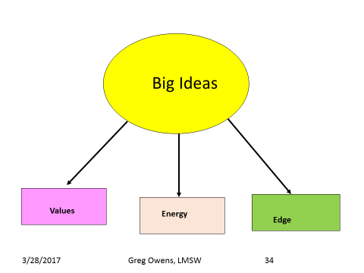

Slide 28
The Paradox of Ideas
Quantum Ideas
(aka BIG IDEAS)
Transformation
What Are Your Quantum/Incremental – Evolutionary/Revolutionary Ideas About Health Equity?
Who Knows About Them?
Where Did They Come From?
Incremental Ideas
(aka little ideas)
Continuous Improvement
Evolutionary Change
Revolutionary Change
Notes:
At the optimal, a winning organization will make every effort to get ideas from throughout the organization, from every level of staff.

Slide 29
Big Ideas Transform
President John F. Kennedy: This nation should commit itself to achieving the goal, before this decade is out, of landing a man on the moon and returning him safely to the earth.
Susan G. Komen® for the Cure: A world without breast cancer.
Novo Nordisk: To prevent, treat and ultimately cure diabetes.
FedEx: The World on Time.
Disney: We Make People Happy
Mattel: To be the premier toy brands — today and tomorrow.
Amazon: To build a place where people can come to find and discover anything they might want to buy online
SpaceX: Enable human exploration and settlement of Mars.
AIESEC: Engage and develop every young person in the world.
Google: Organize the world’s information and make it universally accessible and useful.
Microsoft: A computer on every desk and in every home.
Habitat for Humanity: A world where everyone has a safe and decent place to live.
SolarAid: Eradicate the kerosene lamp from Africa by 2020 through the creation of a sustainable market for solar lights.
Zappos: To provide the best customer service possible

Slide 30
Diagnose Your Organization’s Leadership System - Setting Boundaries
INDICATORS
SYSTEM 1
Exploitative
Autocratic
Down
Only
Top Down
None
Security
Money
Hostile
Mediocre
SYSTEM 2
Benevolent
Autocratic
Mostly
Down
Top Down
Little
Status
Mixed
(toward
negative)
Fair to
Good
SYSTEM 3
Consultative
Up &
Down
At Top, with
Consultation
Some
Growth
Recognition
Mixed
(toward)
positive
Good to
Excellent
SYSTEM 4
Participative
Up, Down, and
Sideways
Group Participation
Much
Identity
Achievement
Influence
Favorable
Excellent
SYSTEM “0”
Laissez Faire
Mixed
(mostly within technical areas)
Mixed
(sometimes not set at all)
Mixed
(mostly on technical issues)
Higher Level
(from outside organization)
Mixed
(positive toward job but
not org.)
Mixed
(poor to good)
COMMUNICATION
TEAMWORK
GOALS SET
EMPLOYEE
MOTIVATION
EMPLOYEE ATTITUDES
OUTPUT
Developed by APHSA

Slide 31

Leadership Tools
Time
Behavior
Attention
Decisions & Assignments
Notes:
Make point that these tools have always been available, that it is a question of whether we are using them to do leadership work or not.

Slide 32

Leadership Competencies
Those discrete skills & abilities that enable you to use the tools effectively.
In order to build capacity throughout the agency we need to assess what behaviors and competencies we need to develop at the individual, team and organizational level.

Slide 33
Communicating Vision and Direction
Promoting Ethics
Leading by Example
Continuous Learning
Strategic Thinking
Decision Making
Systems Thinking
Championing Innovation
Organizational Astuteness
Interpersonal Communications
Developing Leadership
Team Leadership
Supporting the Community

Slide 34
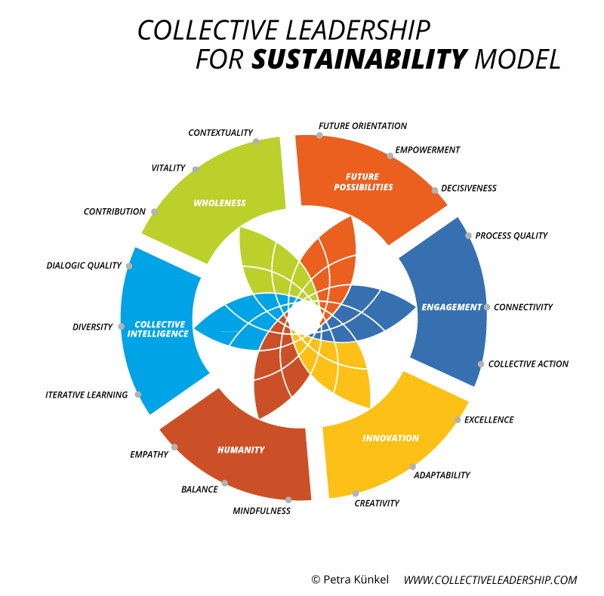


Slide 35
Critical Competencies for 2017and Beyond
Discovery-based learning
Collaborative strategic decision making
Shaping work for meaning
Activating Open Networks

Slide 36
Revisiting 31 Core Competencies
Competencies Dealing with People
  Establishing focus: The ability to develop and communicate goals in support of the business’ mission.
  Providing motivational support: The ability to enhance others’ commitment to their work.
  Fostering teamwork: As a team member, the ability and desire to work cooperatively with others on a team; as a team leader, the ability to demonstrate interest, skill and success in getting groups to learn to work together.
Written by Edward J. Cripe and Richard S. Mansfield

Slide 37
Competencies Dealing with Business
Diagnostic information gathering: The ability to identify the information needed to clarify a situation, seek that information from appropriate sources and use skillful questioning to draw out the information, when others are reluctant to disclose it.
Analytical thinking: The ability to tackle a problem by using a logical, systematic, sequential approach.
Forward thinking: The ability to anticipate the implications and consequences of situations and take appropriate action to be prepared for possible contingencies.

Slide 38
Self-Management Competencies
Self confidence: Faith in one’s own ideas and capability to be successful; willingness to take an independent position in the face of opposition.
Stress management: The ability to keep functioning effectively when under pressure and maintain self control in the face of hostility or provocation.
Personal credibility: Demonstrated concern that one be perceived as responsible, reliable and trustworthy

Slide 39
Leading complex and continuous change
• Get ahead of the change curve by identifying and prioritizing opportunities more quickly.
• Building greater capacity in individuals, teams, units and networks to undertake successful change.
• Understanding the inter-dependencies of multiple simultaneous changes and address them rather than hoping that the competing demands for resources, time and attention will somehow sort themselves out.
• Continuously increase the speed of change by doing it better, not pushing harder.

Slide 40
Pursuing vertical development
• Developing the ability to see patterns and shift systems and processes to enable future possibilities.
• Learning to think in terms of paradoxes or polarities instead of focusing exclusively on the ends of a continuum.
• Envisioning long-term possibilities rather than being paralyzed by current limitations or barriers to innovation.
• Understanding the potential of technology to transform the organization and the world.
• Seeing beyond personal achievement and advancement in order to ignite collaborative efforts to achieve what would otherwise be impossible.

Slide 41
Optional Exercise
How many of these competencies do you (individual) have?
How many does my team (office, group) have?
How many does the organization have?
How will you work to get more competencies for yourself, team and the organization?

Slide 42
The Gap Analysis
Think of a situation that you would like to change or improve.
What is it like now? Be as descriptive as possible.
What would it be like if everything was perfect?
The difference between bullets 2 & 3 is the gap.

Slide 43
Closing the Gap
What will I do to begin to close the gap? What does my team need to do?
What resources do we need?
Whose help do we need? What do we want them to do?
Does this align with other work/projects/initiatives that are already underway?

Slide 44

James Baldwin

Slide 45
Contact Information
Gregory Owens, LMSW
The Rev. Leonard D. Comithier, Jr. Institute
The Macedonia Baptist Church
26 Wilson Ave., Albany, NY 12206 macedoniaofalbany.org ggo1104.go@gmail.com

