Slide 1
Teledermatology and Clinical Image Security
Thursday November 2, 2017, 1:45 PM
Olympic Room 4
Julie Lin, MD
Associate Professor of Medicine
University of Vermont Medical Center, Dermatology

Slide 2
Disclosures
I provide, store and forward teledermatology services in California through Direct Dermatology.

Slide 3
Background
Board Certified in Dermatology and Clinical Informatics.
Medical Dermatology and teaching 40%
Clinical Informatics - operations 40%

Slide 4
Objectives
Review applications of teledermatology
Discuss medical imaging and security

Slide 5
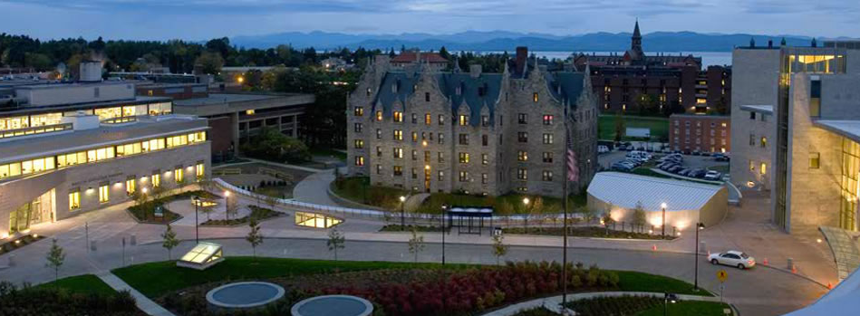
University of Vermont Medical Center
Vermont’s only academic medical center in the state.
Only NICU and Level 1 Trauma Center in the state.
562 licensed beds.
Community Hospital for 150,000 and Regional Referral Center for 1 million people in Vermont and Northern New York.
~600 physicians at the medical center, ~190 community-based physicians.
~300 residents and fellows.

Slide 6
Local Statistics in VT
21 board certified dermatologists in the state of Vermont.
12 practice in the Burlington area
8 are academic dermatologists at the University
4 are in private practice in the immediate area
Remaining 9 dermatologists are in individual practices throughout the state.
Dermatology inpatient consultation is available 24 hours per day only at the University of Vermont Medical Center.

Slide 7
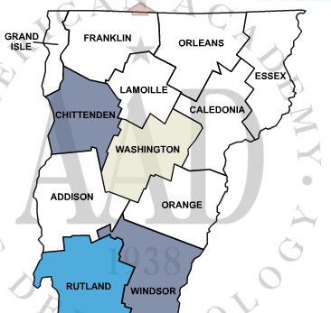
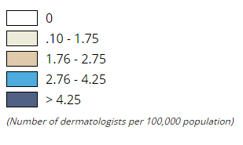
VT Dermatology Workforce

Slide 8
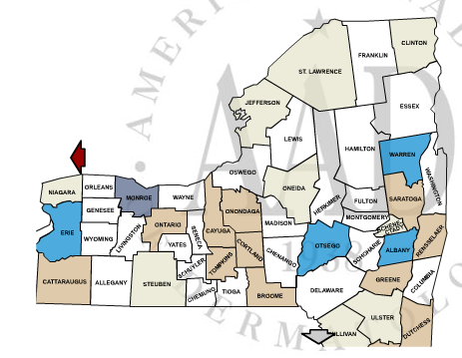
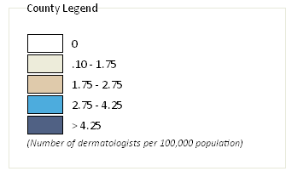
NY - Our Neighboring State
0.9

Slide 9
NATIONAL WORKFORCE SHORTAGE
Surveys from 2002, repeated in 2005 and 2007 by the American Academy of Dermatology.
Mean wait times - new patient appointments decreased slightly from 36 to 33 days .
1/3 of practices continue to seek additional dermatologists.
Despite continued increases in non-physician clinicians in US dermatology offices, only small changes in the overall metrics commonly used to assess workforce balance.

Slide 10
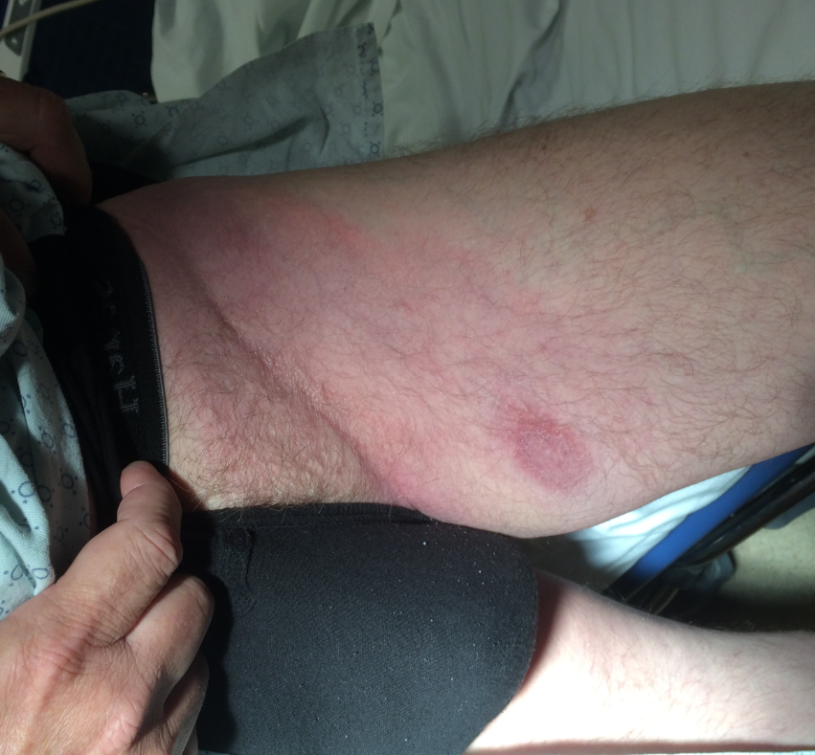

Slide 11
CASE STUDY
Patient presents to ED - late Friday with a persistent rash on the leg present for 3 months.
Already seen prior by two providers – diagnosed with “spider bite” - given antibiotics. Returned to a different provider -prescribed different antibiotic.
3rd return visit, ED provider contacted dermatologist on call who requested an image of the lesion.
Examination of image - provisional diagnosis of Lyme disease - patient given doxycycline and Lyme serologies were ordered.
Dermatologist requested patient be seen the following Monday.
Over the weekend -patient developed facial droop and left-sided weakness- admitted to hospital for extensive work-up (LP, radiology imaging etc.)
Monday AM - rash was barely visible. Lyme serologies and CSF indicated recent infection with Lyme disease.
The dermatologist’s diagnosis of CNS Lyme disease explained the rash, facial palsy and left-sided weakness.

Slide 12
Lessons Learned
Skin disease has a temporal diagnostic and treatment relationship.
The image captured at the time of the emergency room visit led to an accurate diagnosis.
Several providers failed to diagnose Lyme disease at an earlier stage of development, leading to an ED visit and hospitalization.
If patient had access to a dermatologist or teledermatology at the onset of the illness - the patient would likely have avoided the hospitalization that resulted in increased costs to the health system and most importantly, the patient could have avoided the sequelae of late Lyme disease.
One must also account for the personal time lost to the patient travelling to several provider visits and the fear, frustration and anxiety associated with a persistent and unresolved medical problem for several months.

Slide 13
Types of Telemedicine
SYNCHRONOUS - full-motion video, providers and patients interact via live videoconferencing.
ASYNCHRONOUS/STORE AND FORWARD (SAF) - sending or forwarding of digital images and associated patient data to the specialist for storage and consultation.
REMOTE MONITORING - Monitor physiologic measurements, test results, images, and sounds. Usually collected in a patient's residence or a care facility. Supplement to home visits from nursing professionals.
DIRECT-TO CONSUMER – providing direct patient care using technology.

Slide 14
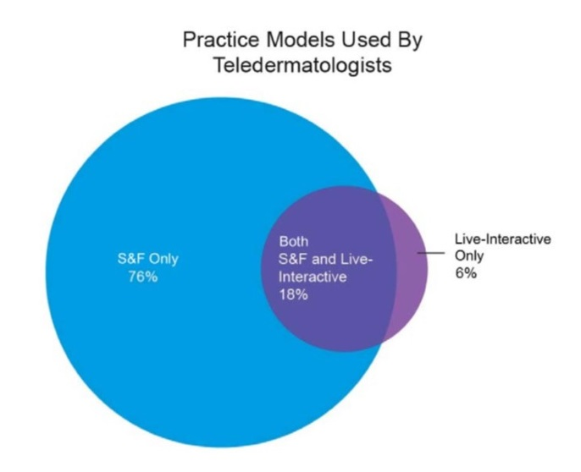
Armstrong AW, Kwong MW, Ledo L, Nesbitt TS, Shewry SL. Practice models and challenges in teledermatology: a study of collective experiences from teledermatologists. PLoS One. 2011;6(12):e28687.. Epub 2011 Dec 14. PMID: 22194887

Slide 15
Access Derm
Free teledermatology platform sponsored by AAD.
Volunteer program
Consult remotely on dermatology cases using mobile devices and or web browser.
Primary care clinicians submit consultations that dermatologists receive on their personal mobile device or web browser.

Slide 16
Access Derm
Can download application on:
iPhone
iPad
Android
Any web browser
Restricted to states that have registered clinics in 16 states
CA, MA, MI, NY, PA, VA, VT, TX, WA

Slide 17
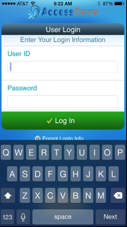
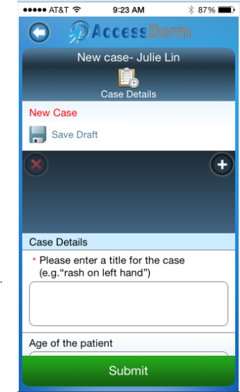

Slide 18
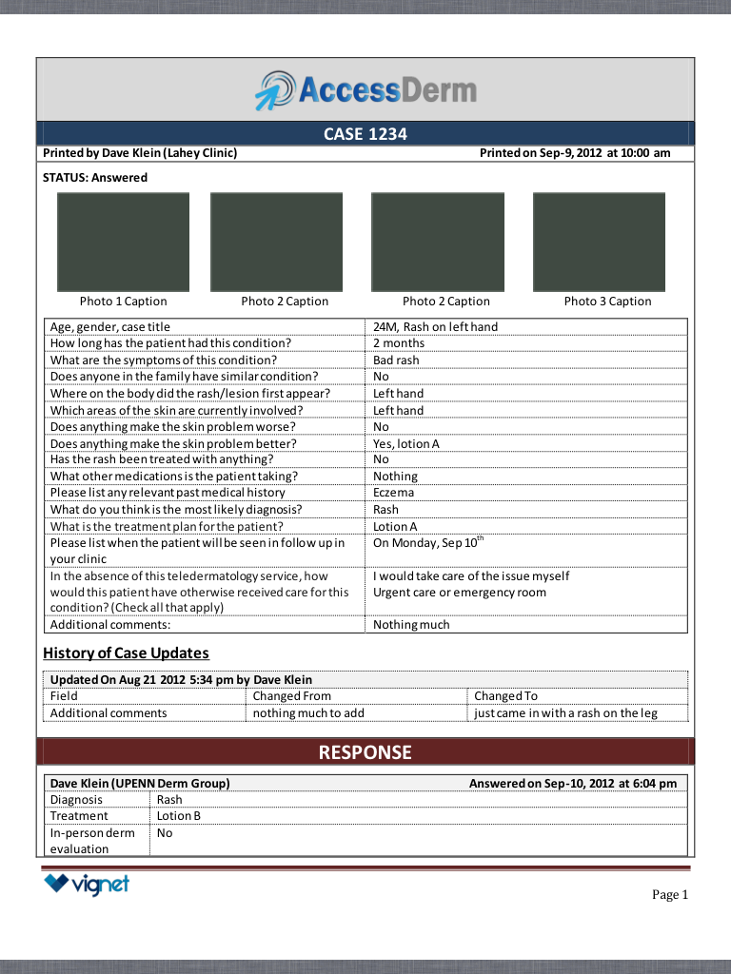

Slide 19
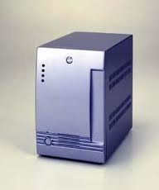
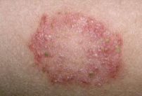
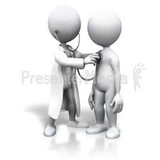
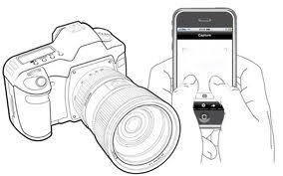
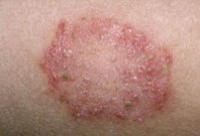
Pilot Teledermatology Workflow
Templated telederm consult entered by MD
Staff transfers telederm consult to access derm app
E-mail alert that consult has been requested
Staff acquires digital image via
Access Derm app
Secured server
E-mail alert that consult
has been answered
Reviews
consult and replies
Patient signs consent

Slide 20
Workflow to Obtain Image in EHR vs Mobile App
Secured server
Image is taken
Memory card is removed from camera and placed in card reader attached to computer
Image file is transferred to computer
Staff or physician imports file to EHR record
TIME
5 minutes
Staff acquires digital image via Access Derm app
Secured server
15 seconds
TIME

Slide 21
Pilot Data
PRE-TELEDERMATOLOGY
# Referrals | 108
Wait Time for Appt. | 60.2 days (0-370 days)
POST-TELEDERMATOLOGY
# Teledermatology Consults | 44
Response Time | 9.2 hours (0.6-39.9 hours)
Wait Time for Appt. | 12.9 days (2-32 days)

Slide 22
PRE-TELEDERMATOLOGY (TRADITIONAL REFERRALS) |  | POST-TELEDERMATOLOGY
DIAGNOSIS | # | DIAGNOSIS | #
Benign neoplasm (ICD-9 216.XX) | 19 | Rash | 25
Actinic keratos(es) (ICD-9 702.0) | 14 | Neoplasm/new growth | 6
Psoriasis (ICD-9 – 696.1) | 13 | Lesion | 6
Neoplasm of uncertain origin (ICD-9 239.2) | 9 | “Don’t know” | 6
Seborrheic keratos(es) (ICD-9 – 702.19, 702.11) | 9 | Pyogenic granuloma | 5
Personal History of melanoma or skin cancer (ICD-9 –V10.83, V10.82) | 9 | “Other” | 3

Slide 23
Further Analysis
47 consults, 3 excluded
Not traceable to an office visit.
Information technology issues.
Of the 44 consults included:
WICC/Family Practice thought 23 of them required office visits.
11 were determined to benefit from office visits.

Slide 24
Diagnosis concordance between the PCP diagnosis and dermatologist consult via AccessDerm was 62.5%.
Diagnosis concordance between the dermatologist’s AccessDerm diagnosis and in-clinic diagnosis was 77%.

Slide 25
Delivered as a single cohesive intervention with care coordination.
Some primary care physicians who referred patients provided background on and obtained digital images of the patient’s skin problems and then uploaded the necessary information to a secure website.
Over time, most referred patients to a more direct care model
Physician referred to brick and mortar clinics to have photographs taken and to be interviewed by trained teledermatology staff.
Teledermatology staff also called the patient to review the diagnosis and treatment plan.
If necessary, an in-person follow-up visit was scheduled at the clinic, where a teledermatologist was regularly onsite.

Slide 26
Telemedicine Billing
GQ modifier – store and forward
GT modifier – live interactive – This is covered in Vermont

Slide 27
Coordination of Care and Interoperability
Besides tethered EHRs, patient portals, or embedded teledermatology functionality in existing EHRs - many teledermatology applications do not exchange health information as discrete data.
APIs (SMART on FHIR) could be a potential solution to the mobile applications that are rapidly being developed.

Slide 28
Workflow Considerations
How will you deliver and coordinate care?
Teledermatology models – consultative, triage, direct to consumer, continuity of care
Telemedicine must be equivalent or equal to an in-office visit.
Need a virtual office - consider all workflows that happen over the continuum of care - not just the exchange of information of one consult at one point in time.

Slide 29
Workflow Considerations
Scenarios
Consult is received – need more information – how will you obtain old path reports, labs, clinic notes? How will you view them, where will they be stored?
You need to contact the patient – do you have translator services? will you call or send an electronic message? Is there a way for the patient to message you?
You are recommending a lab test – are you following this through telemedicine or is the onus completely on the referring provider for management?
Who will be taking the clinical photos and history?

Slide 30
Workflow Considerations
Scenarios
Will you e-prescribe? Need to know local laws.
When you refer a patient for in-person care – how will the referral be done, who’s arranging it, will you get a note and confirmation of the visit?
Are you alerted when there is a message or results waiting for you?
Can you monitor patients and results?
Is there support staff that can support all the workflows?
If you ask a patient to come back for a telederm follow-up, if they don’t show up – will you be alerted?

Slide 31
Parting Thoughts
Not meant for a substitute for clinic dermatology but to provide better access and triage.
Should not be a stand alone service.
Consulting teledermatologist should have network to direct patients to clinic, should the virtual visit be deemed inadequate.
CARE COORDINATION AND WORKFLOW are crucial aspects of teledermatology that should not be neglected.
Need a physician champion.

Slide 32
Clinical Photos: Security and Privacy Issues

Slide 33
Clinical Images
Digital photography, technology, and mobile devices have transformed how care is delivered in medicine.
Kodachromes, polaroids and printed photos are almost obsolete.
Clinical images are now everywhere and easily assessable to many people;
not necessarily intended for their use
Are advances in electronic technology eroding the privacy of health information?

Slide 35
How Are Photos Used In Dermatology?
Clinical Care
To document lesions or patients’ conditions or treatment progress, surgery pre and post-op, cosmetic procedures.
Teledermatology – formal and curbside consults
Dermoscopy
Teaching
Publication
Lectures
No Court-Mandated Format or standards

Slide 36
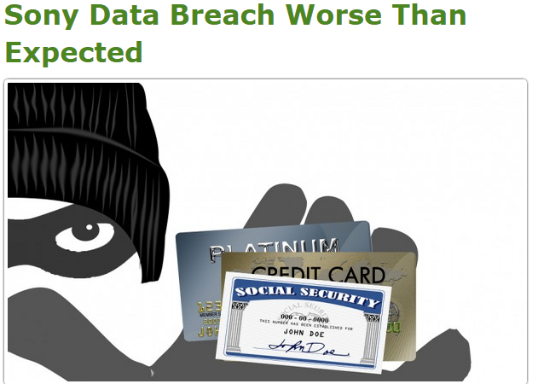
Breaches In Privacy & Threats To Security

Slide 37
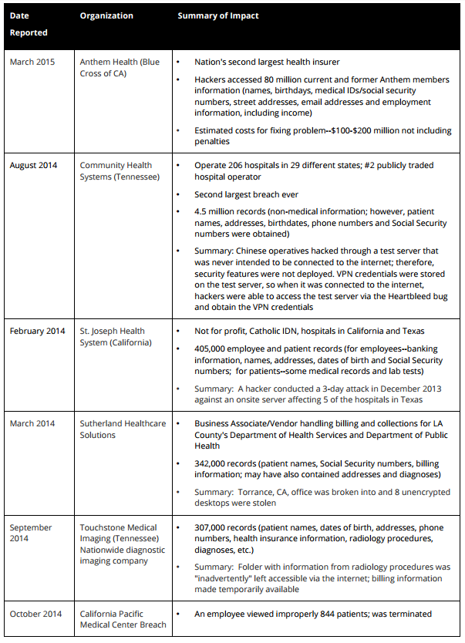
Health Care Data Breaches

Slide 38
How Is This Relevant To Medicine?
The nature of digital technology allows images to be easily copied and transferred.
Uncontrolled distribution of digital images provides opportunities for unauthorized individuals to access protected patient information in the form of clinical images.
Many smartphones area connected to one or more cloud storage servers.
Although this facilitates sharing of images and can act as backup storage, the security of images stored on smartphones and through cloud computing is, in general, insufficient to protect patient photographs.

Slide 39
Audience Survey
Do you use digital photography in your practice?
Do you text or e-mail images to colleagues for advice or opinion?
Do you routinely disclose to the patient the identity of the third party?
Do you take clinical photos on your personal device?
Is your personal phone or laptop encrypted?
Are you concerned about digital vulnerabilities/HIPAA violations if your patient data is stolen or lost?

Slide 40
Covered Entities
Medical service providers
Health insurers
Health care clearinghouses
Employee sponsored health plans
Extended to “business associates” in 2009
Independent contractors of covered entities
Company that rents copy machines to hospitals
Medical app that delivers teledermatology

Slide 41
Business Associates
The HITECH Act of 2009 expanded the responsibilities of business associates under the Privacy and Security Rules.
HHS is developing regulations to implement and clarify these changes.
Business Associate Agreement (BAA).

Slide 42
Protected Health Information(PHI)
Names
All geographic subdivisions smaller than a state, except for the initial 3 digits of the ZIP code, given that the unit formed contains more than 20,000 people
Dates (other than year) directly related to an individual
Phone numbers
Fax numbers
Email addresses
Social Security numbers
Medical record numbers
Health insurance beneficiary numbers
Account numbers
Certificate/license numbers
Vehicle identifiers and serial numbers, including license plate numbers;
Device identifiers and serial numbers;
Web Uniform Resource Locators (URLs)
Internet Protocol (IP) address numbers
Biometric identifiers, including finger, retinal and voice prints
Full face photographic images and any comparable images
Any other unique identifying number, characteristic, or code except the unique code assigned by the investigator to code the data

Slide 43
HEALTHCARE WORKERS BEHAVING BADLY

Slide 44
SCENARIO #1
You post a clinical photo on social media and show it to your friends.
Should you have done this?

Slide 45
DON’T EVER POST CLINICAL PHOTOS ON SOCIAL MEDIA OR THE INTERNET UNLESS YOU HAVE EXPLICIT CONSENT.

Slide 47
Photos Taken of Patients Should Have Clinical Relevance
The Case of the "Hot Rod" Tattoo
December 2007, Adam Hansen, MD, chief resident of general surgery at the Mayo Clinic in Phoenix, Arizona, was fired after he admitted taking a photo with his cell phone of a tattoo of strip club owner Sean Dubowik’s penis, which read “Hot Rod” and then showed it to other members of the surgical staff.
Phoenix surgeon faces discipline after photographing 'Hot Rod's' genitals. Tucson Citizen. December 19, 2007.
http://tucsoncitizen.com/morgue/2007/12/19/71932-phx-surgeon-faces-discipline-after-photographing-hot-rod-s-genitals

Slide 48
ONLY TAKE PHOTOS FOR THE PURPOSE OF TREATMENT, PAYMENT OR OPERATIONS. DON'T TAKE THEM FOR "FUN“.

Slide 49
Digital Images And Practical Jokes
Oral surgeon, Robert Woo, may have pulled off the ultimate practical joke.
He stuck fake boar tusks in a patient’s mouth while she was sedated, took pictures, and later - she sued.
Walter (Vietnamese potbellied pig) was the pet of Woo’s surgical assistant and a frequent office topic. The assistant, who worked for Woo for about five years, adored Walter. But ever the jokester, Woo couldn’t resist barbs about barbecuing Walter.

Slide 50
SCENARIO #2
Should you obtain written consent for clinical images (Is verbal enough)?

Slide 51
Most patients feel that use of images for medical education is a gallant purpose and will grant permission for taking and use of their photographs of clinical findings to 'help someone else,'"
However, "medical education" is a concept not fully understood by patients.
Case conferences, lectures both in and outside the medical institution, patient education, medical-legal education, web-based education, photography competitions, commercial educational products, and journal publication, both print and electronic, are all venues which could fall under the heading of "medical education." This should be carefully explained to the patient.

Slide 52
Is Written Consent Needed?
Consent serves as some protection for the photographer and institution from being sued for damages from violations of privacy, defamation, or anguish.
While written consent does not prevent a lawsuit, it may make it more difficult to prosecute.
Any photograph where a patient is identified, particularly the face, written consent should be obtained and placed in the medical record, even if the photo is being used only for educational purposes.

Slide 53
PATIENT’S AUTHORIZED PHOTOGRAPHS USED IN A MANNER NOT ANTICIPATED BY PATIENT
Liability issues can arise when medical practices use patient photographs for promotional or educational purposes.
UVMMC policy – verbal consent - for patient care.
For any other purpose – get written consent - be explicit – even if “unidentifiable.”

Slide 54
HIPAA permits photographs of patients to be used for internal educational activities, such as onsite teaching and training programs. However, photographs cannot be used for external educational activities without first obtaining patient consent to do so.
Under HIPAA, verbal consent is not sufficient, written consent is required. "The best practice is always to obtain a written consent or authorization from the patient specifically allowing the use of photographs for educational purposes“.
Such authorization provides the maximum protection to the physician and the hospital.

Slide 55
Don’t Post Patient Photos On Your Office’s Website Without Explicit Consent
Jan 2011 -Summary judgment was granted on June 10th to plaintiff Catherine Manzione in a multi-million dollar lawsuit. Plaintiff is seeking $23 million.
An elective cosmetic rhinoplasty performed.
Two poorly worded consents were signed;
“Medical research, education, or science will benefit from their use, such photographs and related information may be published and republished in professional journals or medical books, or used for such publication or use, including as presentation material.”
In 2013, the patient discovered her before-and-after photos were posted on the doctor’s website.
Practice website was argued to be an educational forum, authorization to use photos is limited to publication in professional journals or medical book. The surgeon’s website is neither.

Slide 56
Be Explicit When You Consent
A granular consent to use photos might include:
The usage of these photographs, videos and/or digital images will be limited to:
___ Medical purposes related to case
___ Scientific purposes, including seminars and medical articles
___ Digital or printed materials for patients to view in the office(s)
___ Digital or printed materials to be included in newsletter to be sent to
current or prospective patients
___ Digital images to be included in our website
___ Digital images to be uploaded to the broader Internet to be viewed
by the public

Slide 57
Retraction Policy
Additional language into a “Consent to Use Photos” may be helpful:
If I ask Dr. X to terminate use of these photos, videos and/or digital images, I will do so in writing and communicated to Dr. X, and recognize that it will likely take a reasonable time period to accomplish. For example, to remove such pictures from a web site, Dr. X will need to coordinate with a third party webmaster.
Further, termination of prospective use of photos, videos and/or digital images may have no effect on prior distribution- such as the case with medical journals. A published journal, for example, cannot be “recalled.”

Slide 58
Journal Consents for Submission

Slide 59
Educate Your Staff
Good Intentions Can Still Have Consequences.
“One of my assistants took it upon herself to make a booklet for exhibit at seminars without my knowledge or input. She never got permission from any of the patients. Fortunately, I found out about it when one of the patients told me on a visit and fortunately the patient wasn’t upset! Common sense is so uncommon these days”

Slide 60
Metadata in Digital Images
Metadata - "data that provides information about other data“.
Photos taken from mobile devices can track locations and dates (geotagging) – TURN IT OFF!
Hovering over a photo in a web browser can show information you did not intend to share – DELETE ALL METADATA!
Don’t name file names by patient names!

Slide 61
THERE'S MORE THAN MEETS THE EYE.
A CLINICAL PHOTO IS NOT JUST “SKIN DEEP.”

Slide 62
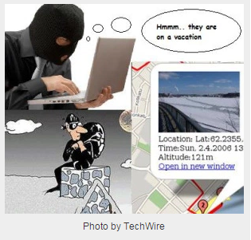
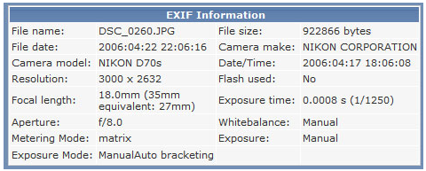
Geotagging
Photos are tagged with location data.
Metadata (called EXIF) will have this location information embedded to it.
Disabling only works within the stock camera app. Other apps that access camera (like Instagram, Twitter, Facebook, Camera+, Whatsapp) will still be able to tag location data to your photos.

Slide 63
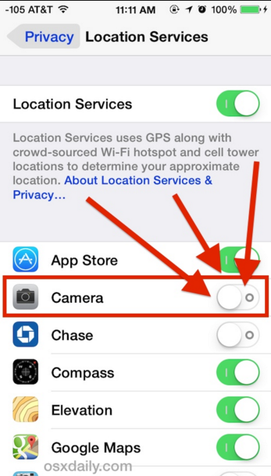
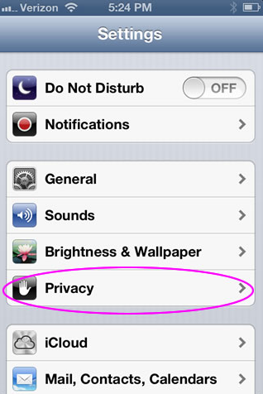
How To Turn Off Geotagging

Slide 64
“One surgeon learned that a de-identified photo had the patient’s name embedded in file name/properties feature of the link. In other words, right click on the picture… voila …the patient’s name appeared within the file name for the picture. This came as a surprise to the patient who followed by calling an attorney.”

Slide 65
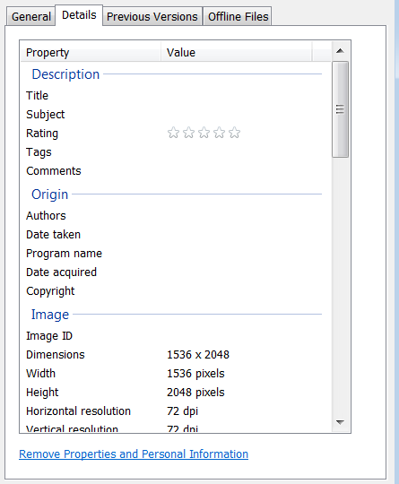
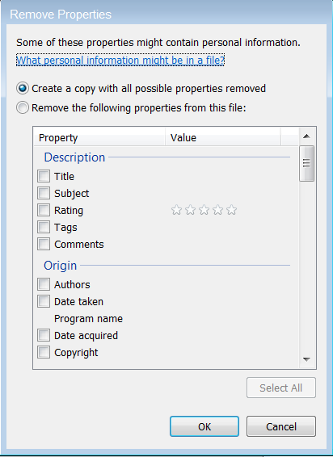
Metadata

Slide 66
The Curbside Consult
Risk Management
Okay to receive photos in an informal “curbside consult”
Have no control over what the consulting provider is documenting in the medical record
The sender of the photograph is seeing the patient in the context of a formal patient encounter and it is their responsibility to place the photos in the medical record
Security Officer
The onus is on the sender of the photo to send it securely and get consent
If you reply to that text or e-mail about diagnosis or treatment, you are responsible for the information
Don’t store the photo
Compliance
If used for the purpose of treatment, payment or operations, it is part of the medical record. Sender of photo needs to place in record.
Potential solution-if one party has encrypted e-mail. Send encrypted e-mail back and forth. Can be initiated on either side.

Slide 67
SCENARIO #3 The Patient Wants To Send You A Photo

Slide 68
Is This A Patient Encounter?
Patient portals allow patients to send photos that file directly to the EHR.
Personal decision if you want to give out your e-mail or phone number.
If this is an established patient, this is an interaction – Best Practices: document in the record as an encounter and the photo should be filed.
Do you normally document telephone calls in the chart? Is this interaction any different?

Slide 69
Methods to Secure Information
Deterrents
Alerts
Audit trails
Risk management systems
Software management
Vulnerability analysis
Obstacles
Authentication
Authorization
Integrity management
Digital signatures
Encryption
Firewalls
Rights management

Slide 70
SCENARIO #4
Should you take a clinical photo on your cell phone?

Slide 71
Yes, but don’t store the photo on your phone, delete it once it’s in the EHR or in a secure folder.
Turn off geotagging and delete all metadata if you post it or reuse it (after you get consent).

Slide 72
How Should You Take and Store Images?
Use a secure app if available.
Do not back-up/upload to cloud.
Do not store on native camera roll.
It is now part of the medical record.
Once an image is acquired, the dermatologist must be prepared to retain the chart (electronic or paper) and images for as long as the medical records are kept and not lose track or discard this image.

Slide 73
HIPPA Compliant Storage and Communication Systems
HIPPA Compliant Technology | Company | System Description | Website
Imprivata Cortext® | Imprivata | HIPAA-compliant communications platform | http://www.imprivata.com/ secure-communications14
Firehost Secure Cloud Hosting® | FireHost Inc | HIPAA-compliant cloud storage | http://www.firehost.com
CareCloud® | CareCloud | HIPAA-compliant cloud Storage | http://www.carecloud.com
qliqSoft® | qliqSOFT | HIPAA compliant text Messaging | https://qliqsoft.com
Medigram® | Medigram, Inc | HIPAA-compliant group messaging (HCGM) | https://medigram.com/
HippaChat® | Everbridge | HIPAA-compliant text messaging and video calls like FaceTime or Skype | http://www.hipaachat.com/
FotoFinder Handyscope® | FotoFinder Systems | HIPAA-compliant iPhone photo application | http://www.handyscope.net20
tKDerm Touch® | TKDERM dermatological database | HIPAA-compliant iPhone photo application | http://www.tkderm.sourcefor ge.net21

Slide 74
UVMMC’s Approach To Security
Education
Encrypted e-mail
Cannot export data without hospital issued encrypted thumb drive
Cortext (Imprivata) – secure texting - Siri is turned off
Haiku/Canto/Rover mobile app via EPIC (tethered EHR that allows clinical image capture)
Verbal consent for photos
Worx Mobile
Remote wipe
Technical Standards Review Board– all new technology is vetted

Slide 75
Recommendations
Do not store any clinical photos on your personal mobile device.
Don’t back up clinical photos to cloud services unless you are confident it is secure.
Turn off location services in the camera app on your phone if you take clinical photos with a mobile device.
Securely store your images
Encrypted thumb drive
Encrypted labtop
Secure folder
Securely transport your images
Secure texting (encrypted)
Secure e-mail (encrypted)
Secure cloud? (if it exists)

Slide 76
Recommendations
Never take a photo without some type of consent (including during lectures).
When you give a talk - do not distribute clinical photos in electronic format unless you have consent.
Never post any clinical photos on social media unless you have consent.
If your EHR has a mobile app and allows photos to store directly into the EHR, use it. They can be retrieve for educational purposes, but no well thought out process to retrieve images.
If your EHR has a patient portal – use this workflow if the patient want to send you their own photos.

Slide 77
Key Points
Digital images are ubiquitous – need to change how we manage its storage and movement.
There are no standards on the formats of digital images or how to store or transport them.
New area medically and medico-legally and physicians should be knowledgeable as changes happen.
“It is paramount that if an image is taken for clinical purposes that it be considered part of the medical record and treated with the same care as the medical record itself.”

Slide 78
QUESTIONS?.........
Julie.lin@uvmhealth.org

