Slide 1
Lead • Empower • Innovate
Community Members Leading Change
PRESENTED BY:
Amber Guyette
Community Engagement Facilitator
Victoria Knierim
Community Engagement Facilitator
September 21, 2017
Notes:
Talk about implicit bias and suspending opinions throughout presentation. View information in an objective fashion.

Slide 2
Presentation Objective
To discuss the purpose, structure, and outcomes of the AHI PPS Community Advisory Council.
Notes:
Talk about the methods we’ve used to communicate to stakeholders.

Slide 3
Activity
Brainstorm rules within your organization that must apply to everyone who enters the building.

Slide 4
Maslow’s Hierarchy of Needs
Notes:
Lower 3 levels are underlying issues addressed by concrete thinking (roots of tree)
Top 2 levels are the surface issues we are currently treating. Requires abstract thinking. Smoking cessation, exercise, balanced diet belong here

Slide 5
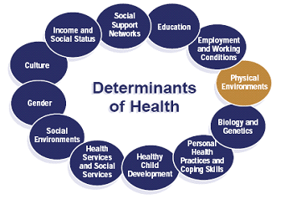
Determinants of Health

Slide 6
Decision Making Team
Transportation Authorities
Housing Authorities
Other Interested Parties
Associations
Education
Unions
Business Community
Human Service Agencies
Insurers/ Other Payers
Government Organizations
Disability Organizations
Public Health
Community-Based Organizations
Providers From All Sectors
Rural
Health Networks
Hospitals/ Health Centers
Consumers
Behavioral Health

Slide 7
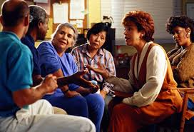
Community Advisory Council
We have created a PPS-wide Community Advisory Council to support both the Patient Activation (2.d.i) Project team and the Community and Beneficiary Engagement Committee to meet their goals.

Slide 8
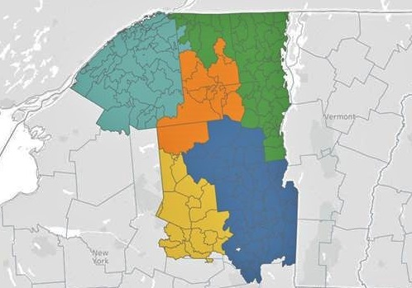
Community Advisory Council
There is one Community Advisory Council satellite group per geographic location based on AHI PPS Population Health Network (PHN) structure.
Administrative support is provided at meetings by AHI’s Community Engagement program staff.
St. Lawrence County Region
Plattsburgh Region
Saranac Lake / Essex County Region
Queensbury / Glens Falls Region
Fulton County Region

Slide 9
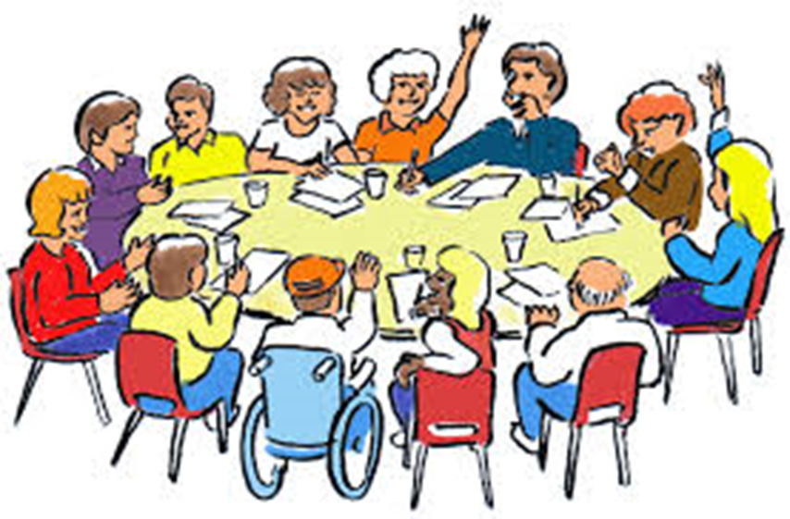
Community Advisory Council
The Community Advisory Council is comprised of individuals who receive Medicaid or are uninsured.
Referred by our partners because they have been identified as strong self-advocates with an interest in improving the health care system in their community.

Slide 10
Community Advisory Council
A peer to peer model is used. Members are encouraged to refer friends, family members, or other acquaintances.
Members choose their own leadership, determine meeting frequency and locations, and designate 2 individuals per location to represent the Council on the Community and Beneficiary Engagement Committee.

Slide 11
Community Advisory Council
What does the Council do?
Provide input about issues impacting access to healthcare in their communities and share their ideas for possible solutions
Participate in creating a strategy for increasing utilization of preventative care
Function as a focus group to inform DSRIP project development

Slide 12
Community Advisory Council
What does the Council do?
Identify gaps in services, as well in outreach and education efforts.
Discuss issues of cultural competency and health literacy and provide input on PPS CC/HL strategy.
Provide feedback for developing community engagement strategy, planning community events, and encouraging involvement in PPS activities in their communities.

Slide 13
Community Advisory Council
Membership is incentivized by:
Providing food at meetings.
Encouraging members to bring their children or other family members in their care.
Assisting members with overcoming transportation barriers.
Holding meetings outside of traditional business hours.
Providing gift cards each meeting as compensation for their valuable time and insight.

Slide 14
Community Advisory Member Quotes
“I feel like I’m disappearing.”
“We need human interaction more than material.”
“Organizations expect consumers to find information they don’t know themselves.”
You don’t go to Dunkin Donuts for a hamburger. You go to Dunkin Donuts for a coffee. But human services shouldn’t be like fast food.”
Notes:
Discuss how the AHI PPS engages community groups and LGUs.
Explain how provider agreements are being implemented and if there any disconnects.

Slide 15
Accomplishments
Pharmacy Delivery List
Medicaid Flow Chart
List of locations to place informational material
List of volunteer opportunities in each area
List of intake questions to be asked upon initial meeting
Notes:
Review our list of accomplishments to date and show how we’ve been doing it.

Slide 16
Call to Action
In order to move forward in creating change…
Organizational leaders to work with us to move ideas/infographics forward.
Involve clinical offices.
Notes:
Discuss challenges.

Slide 17
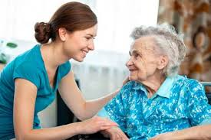
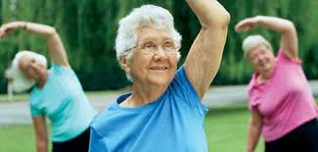
Thank You!
Thank you for helping us build a healthy future!
Notes:
It’s very easy to forget why we are doing a project like this and to become frustrated with the additional time and resources it may take to implement it. Remember that at its core, this project is about people. It’s about empowering our friends and neighbors, our communities as a whole, to take better care of themselves and their loved ones. Thank you for participating!

Slide 18
Amber Guyette aguyette@ahihealth.org
Victoria Knierim vknierim@ahihealth.org
www.ahihealth.org | 518.480.0111

