Slide 1
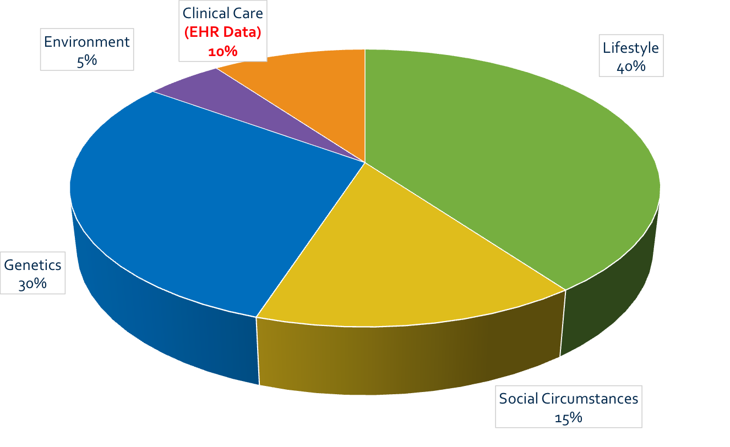
Here’s the Problem…
Determinants of Health
Source: McGinnis, et al. Health Affairs. (2002)

Slide 2
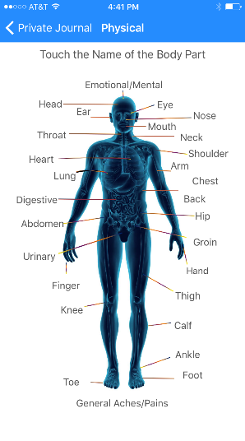
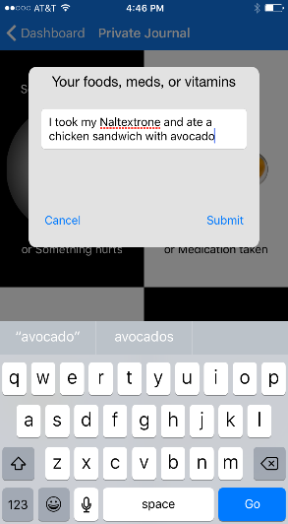
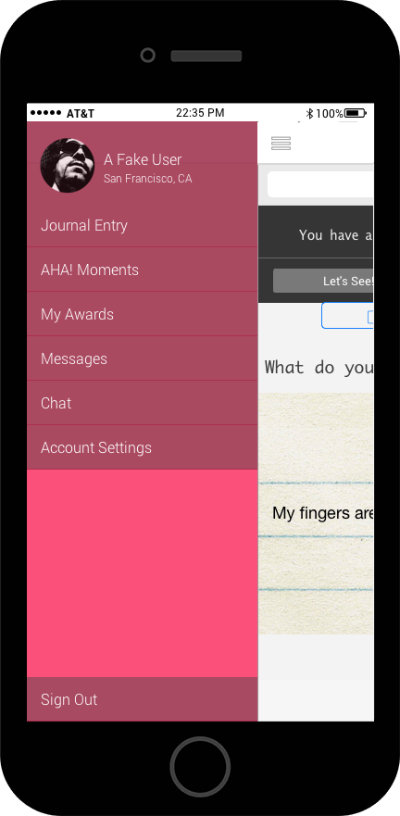
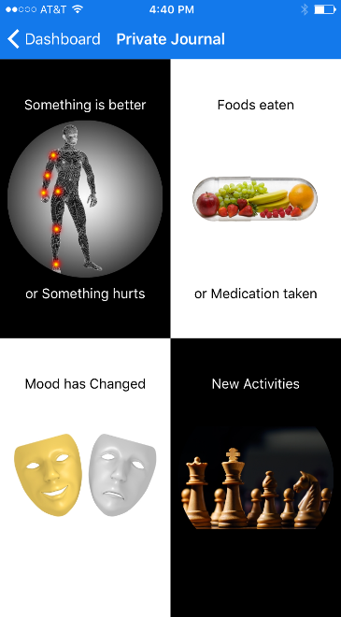
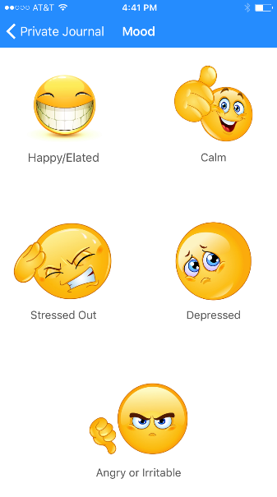
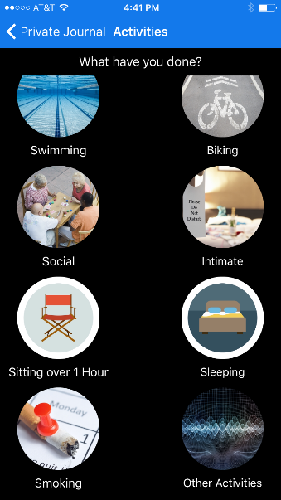
AHA! Journal – Capturing the Phenotype
Speak or type your journal entry on any screen

Slide 3
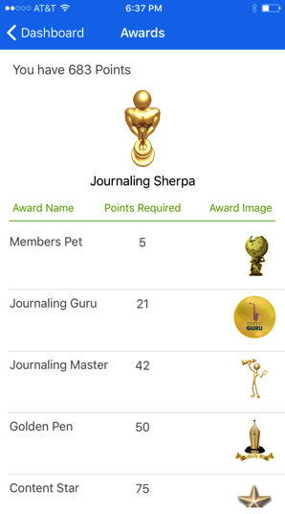
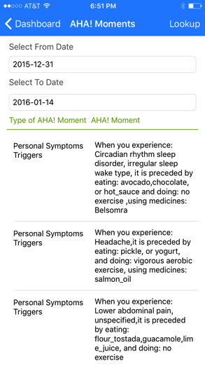
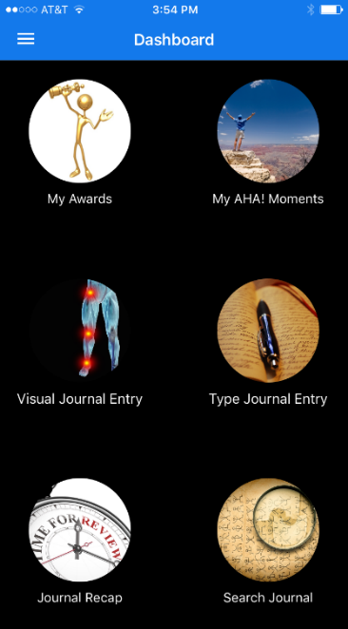
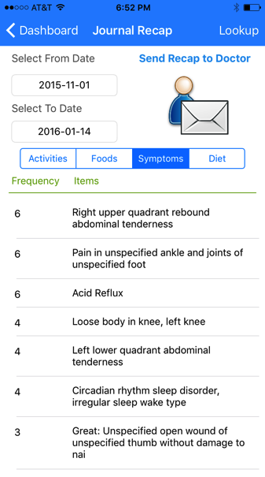
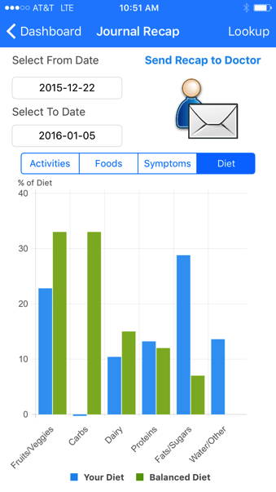
Patient Engagement and Actionable Information

Slide 4
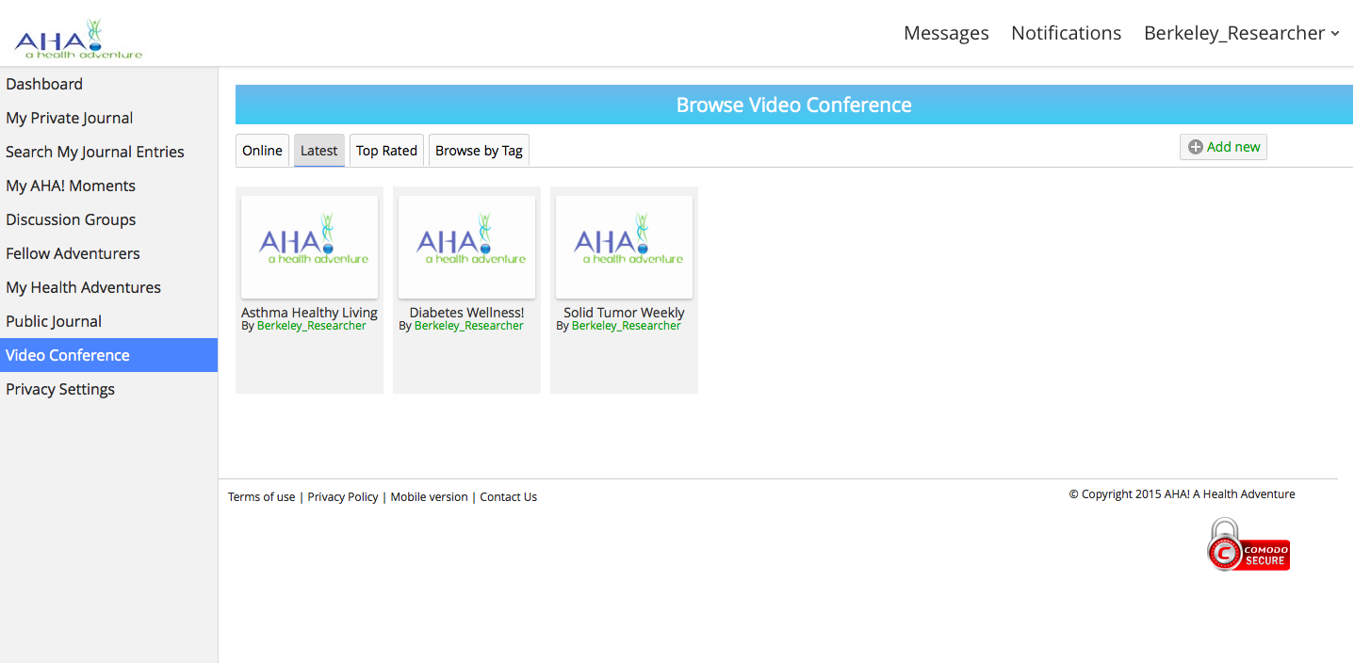
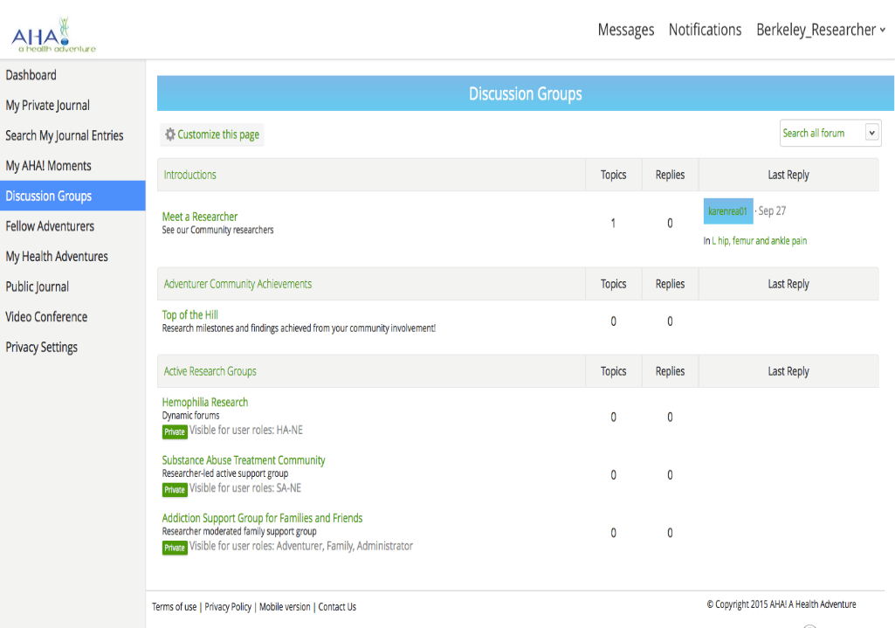
Virtual Health Communities
Educated self-management, and support are the primary ways to stay on track with care and treatment
In between doctor visits, searching the Internet is how people ‘solve’ for their ailments ; its best if they have the Virtual Health Community to interact with

Slide 5
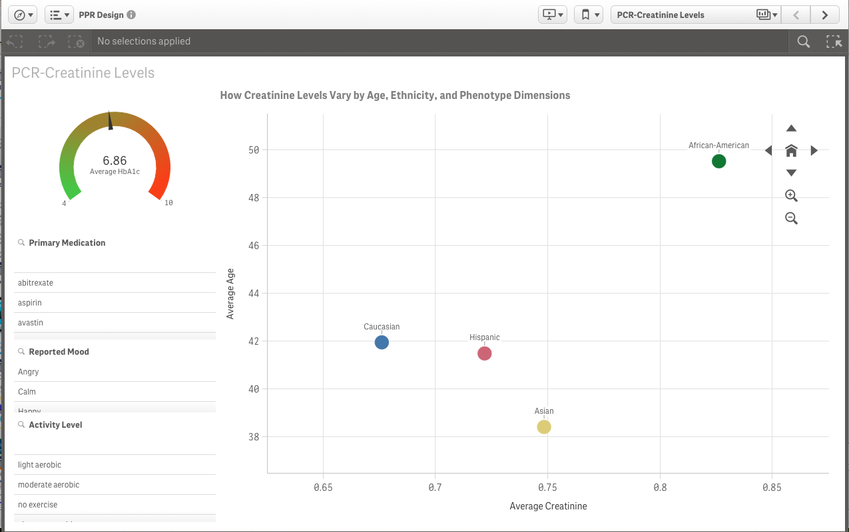
Cohort Level Interactive Analytics

Slide 6

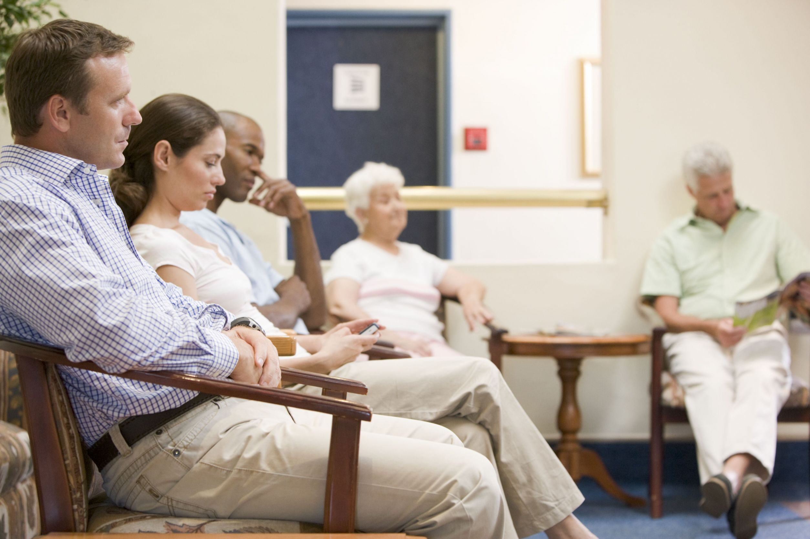


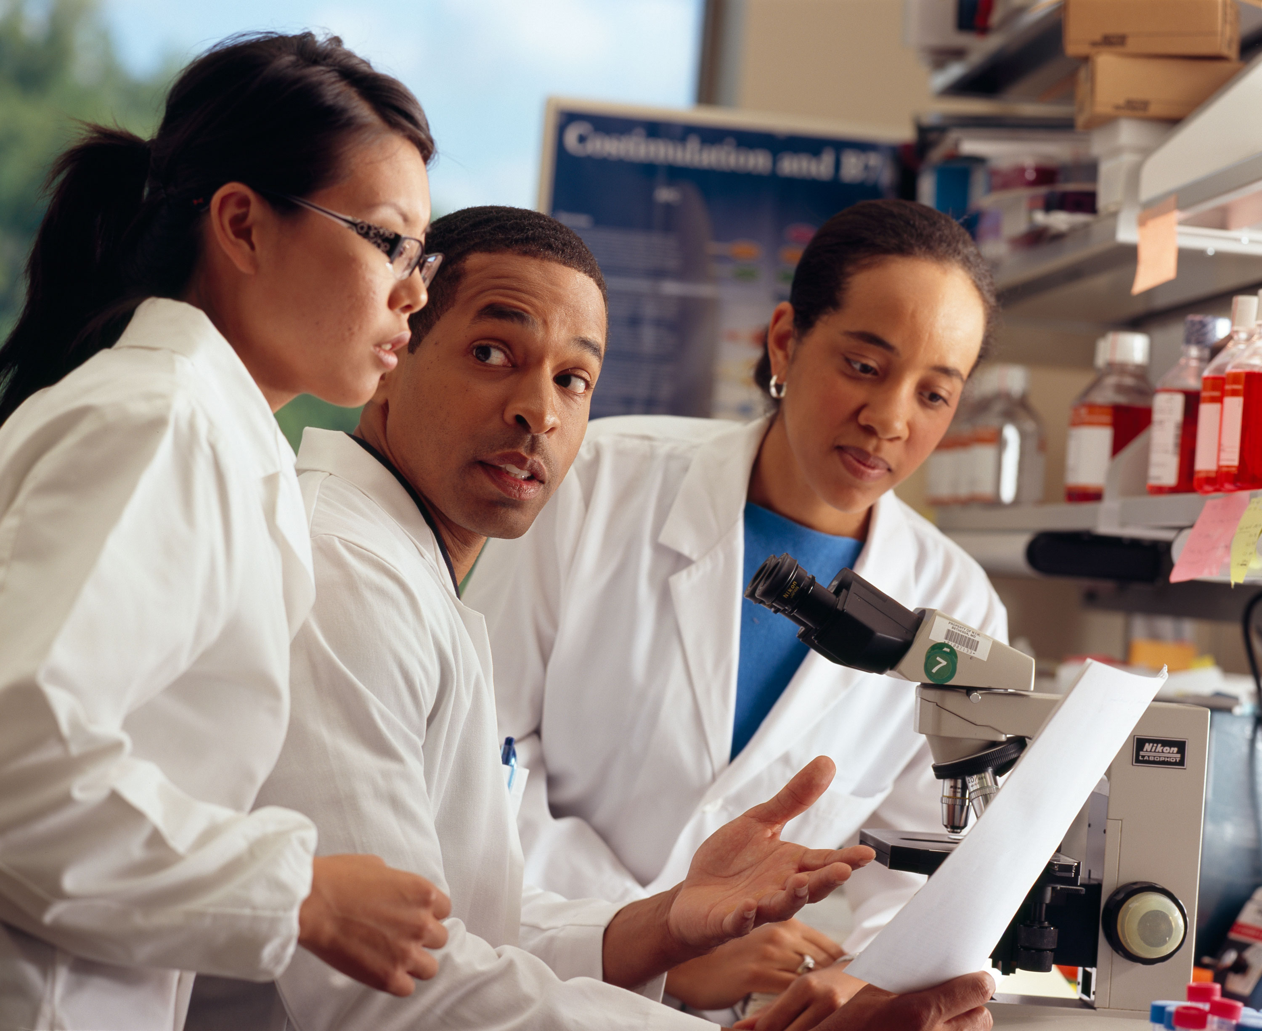
AHA! Value Proposition
  Greg Robinson, PhD - CEO
  Greg.Robinson@ahealthadventure.com
  (508) 499-8774

Slide 7

NOW FOR SOMETHING COMPLETELY DIFFERENT
“Social Marketing Best Practices and Examples from Around the World”
John Justino,
Director, Center for Global Health
University at Albany
School of Public Health

Slide 8
Social Marketing Best Practices
and Examples from Around the World
Marketing Products….
Marketing Global Health….
What’s the difference?

Slide 9
Social Marketing Best Practices
and Examples from Around the World
Marketing Products… Fanta is fun!

Slide 10


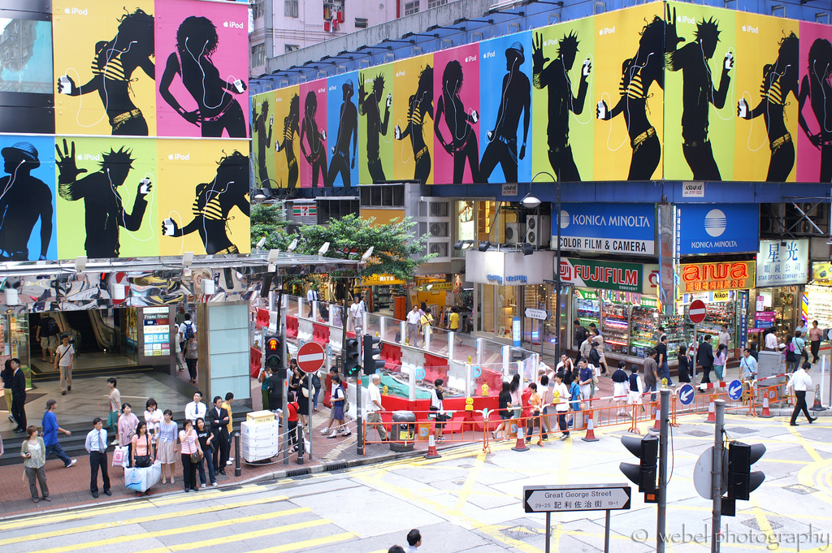
Social Marketing Best Practices
and Examples from Around the World
Marketing Products… iPods are cool!

Slide 11
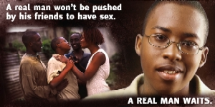


Social Marketing Best Practices
and Examples from Around the World
Marketing Global Health… delaying sex is smart & cool !
Example: “Real Man, Real Woman” Campaign in Southern Africa
Example: “Nimechill” / “I have chilled” Abstinence Campaign in Kenya

Slide 12
Social Marketing Best Practices
and Examples from Around the World
What is Social Marketing?
“…a process for influencing human behavior on a large scale, using marketing principles for the purpose of societal benefit rather than commercial profit.” (W. Smith, Academy for Educational Development)
  Utilizes the“4 Ps” (Product, Price, Place, and Promotion) and often a “5th P” for “Policies”
  Relies an audience-driven approach
  Segments audiences into groups that are as homogenous as possible
  Focuses on “exchange of value”

Slide 13
Social Marketing Best Practices
and Examples from Around the World
Social Marketing programs use Social and Behavior Change Communication (SBCC) to change behaviors
Including the consistent and correct use of health products and services
Social Marketing programs use evidence-based communication to positively influence a person’s
Opportunity, Ability and Motivation to perform a targeted behavior

Slide 14
Social Marketing Best Practices
and Examples from Around the World
Social Marketing Framework
IMPROVED HEALTH STATUS/QUALITY OF LIFE
That improve health
HEALTHY BEHAVIOUR AND/OR USE OF HEALTH PRODUCT
To change behaviours
AT RISK POPULATION
OPPORTUNITY ABILITY MOTIVATION
Availability
Brand
Appeal
Knowledge
Attitudes
Belief
To influence
Brand Attributes
Quality of Care
Social Support
Intentions
Locus of control
Outcome expectation
Social
Norm
Self
Efficacy
Subjective norm
Threat
Willingness to pay
POPULATION CHARACTERISTICS
SOCIAL MARKETING INTERVENTION
Implement activities
PRODUCT PRICE PLACE PROMOTION
Source: PERForM Framework, Population Services International (PSI)

Slide 15
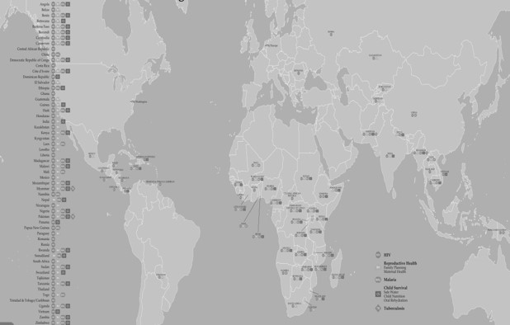
Social Marketing Best Practices
and Examples from Around the World
Who is Population Services International (PSI)?
“PSI is a leading global health organization with programs targeting malaria, child survival, HIV, reproductive health and non-communicable disease. Working in partnership within the public and private sectors, and harnessing the power of the markets, PSI provides life-saving products, clinical services and behavior change communications that empower the world's most vulnerable populations to lead healthier lives.”
PSI works in more than 60 countries around the world
HIV prevention, malaria prevention and treatment, family planning, and maternal & child health
Social franchising of private sector clinics

Slide 16
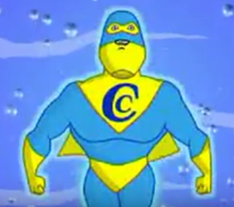
Social Marketing Best Practices
and Examples from Around the World
Let’s look at a few humorous examples from around the world
Captain Clorin (safe water chlorination solution)
http://www.youtube.com/watch?v=NQE2pXP6WTI
Targeted Behavior: Consistent use of Point-of-Use Water Treatment (for diarrheal disease prevention)
Primary Target Group: Caregivers of school-aged children in Zambia
Influencing Motivation and Ability

Slide 17
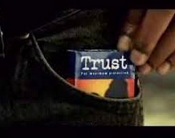
Social Marketing Best Practices
and Examples from Around the World
Let’s look at a few humorous examples from around the world
Kenya - Trust Condom (male condom brand)
http://www.youtube.com/watch?v=NsYNvSDxA6Q
Targeted Behavior: Consistent condom use (for HIV and STI prevention)
Primary Target Group: Sexually active males 15 – 24 years of age in Kenya
Influencing Motivation (brand appeal, social norms and reducing stigma)

Slide 18


Social Marketing Best Practices
and Examples from Around the World
Social Franchising… an innovative model to promote quality services
“A ‘social franchise’ is a network of private sector healthcare providers that are linked through agreements to provide socially beneficial health services under a common franchise brand. A 'franchisor' (typically a non-profit) manages the brand and oversees the administration of the program.”
Voluntary Testing and Counseling for HIV
Social Franchising of Reproductive Health Clinics
Male circumcision for HIV prevention

Slide 19

Social Marketing Best Practices
and Examples from Around the World
The“truth” Smoking Cessation Campaign in the U.S.
Branded behavior change communication strategy to promote cigarette cessation among young people in the state of Florida
Campaign originally developed in 1998 by the Crispin Porter + Bogusky marketing/ad agency
Funded through legal damages paid by “Big Tobacco” to Florida
The “truth” branded smoking cessation campaign has expanded and is still effectively targeting American youth with anti-smoking messages

Slide 20
Social Marketing Best Practices
and Examples from Around the World”
“truth” Smoking Cessation Campaign in the U.S.
Key Research Finding
Tobacco brands in particular fulfill and connect at almost every “need state” of teenagers (taking risks, rebelling, fitting in, independence, self-expression and respect)
SMOKING Rebellion Sign of independence Peer conformity | NOT SMOKING Reduces risk of distant health problems
Smell / yellow teeth Possible health problems – distant future
_{Take risks}
Benefits
_{Rebel}
_{Express}
_{themselves}
_{CONTROL}
_{Be}
_{independent}
Costs
_{Feel respected}
_{Fit in}
Source: “truth” campaign developed by Crispin Porter + Bogusky Agency

Slide 21
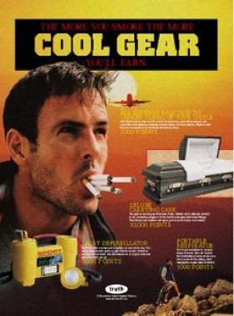
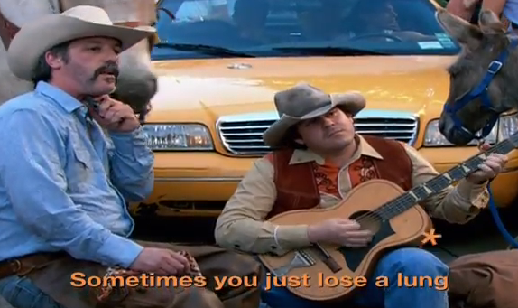
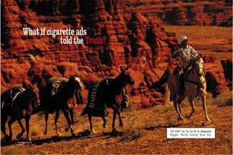
Social Marketing Best Practices
and Examples from Around the World
“truth” Smoking Cessation Campaign in the U.S.
Armed with this perspective, marketers came up with a new brand/brand position able to fulfill these “need states” and provide a sense of control
A brand to match big tobacco brands “toe-to-toe”
Source: “truth” campaign developed by Crispin Porter + Bogusky Agency

Slide 22
Social Marketing Best Practices
and Examples from Around the World
“truth” Smoking Cessation Campaign in the U.S.
Early Results:
Reductions in Prevalence:
  From 1998 to 2001, cigarette use in Florida declined by 47% among middle school students and by 30% among high school students
  This represented 74,657 fewer youth smokers and 24,637 fewer smoking related deaths
30.0%
1998
1999
2000
2001
27.4%
25.2%
22.6%
20.0%
18.5%
19.0%
15.0%
11.1%
10.0%
9.8%
0.0%
Source: “truth” campaign developed by Crispin Porter + Bogusky Agency
Middle School
High School

Slide 23
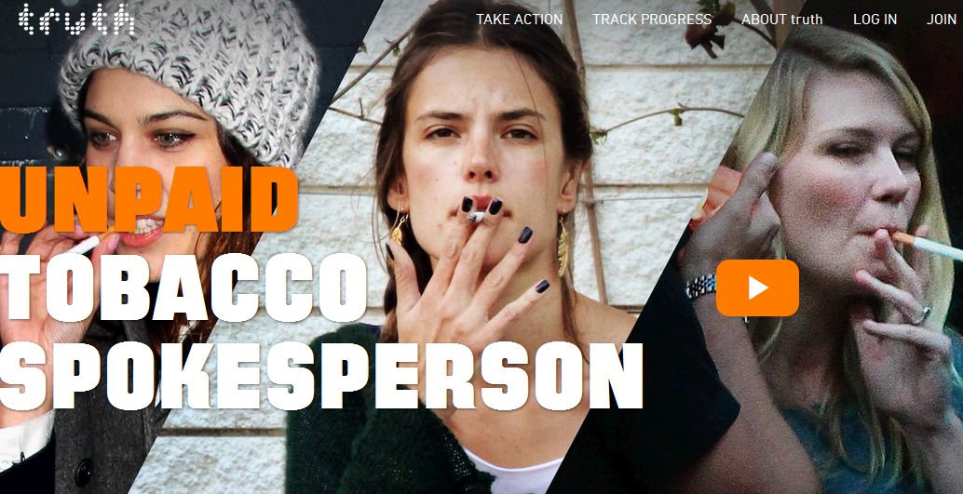
Social Marketing Best Practices
and Examples from Around the World
“truth” Smoking Cessation Campaign in the U.S.
Some more examples of recent “truth” television spots/public service announcements (PSAs)
truth's “Shards O’ Glass” Campaign:
  http://www.youtube.com/watch?v=PbQ4JNpXPTY
truth's “”Second Hand Smoke” Commercial:
http://www.youtube.com/watch?v=v4Ylwj1q9m8
truth MTV Commercials:
The Blaze: http://www.youtube.com/watch?v=0FeBBZImBGg
http://www.youtube.com/watch?v=jbNwz9XwPDg
        http://www.youtube.com/watch?v=GlkgeMXQbBU

Slide 24
Social Marketing Best Practices
and Examples from Around the World
Thank you for your attention!
I hope you learned something useful
and that you enjoyed a laugh or two along the way.
And I hope you are now ready to do some
creative and innovative thinking with Cheryl
on issues that hit a bit closer to home.
John Justino
Director, Center for Global Health
University at Albany School Public Health
(jjustino@albany.edu)

Slide 25
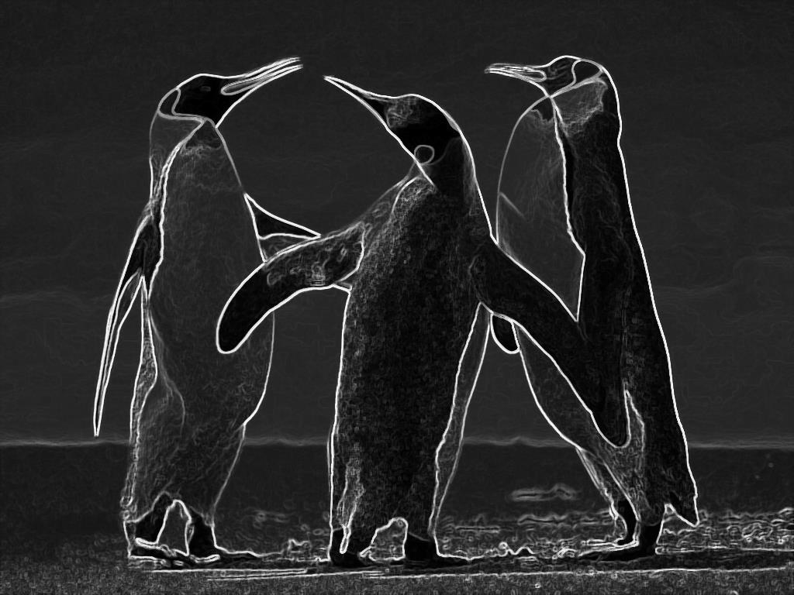
SO
CI
AL
USING INNOVATION for
COMMON GOOD
ONE
MISSION:
HEALTH

Slide 26


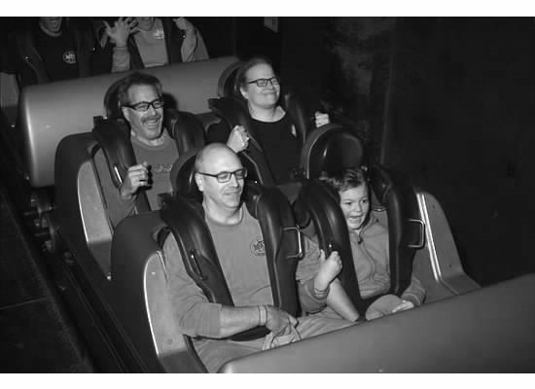
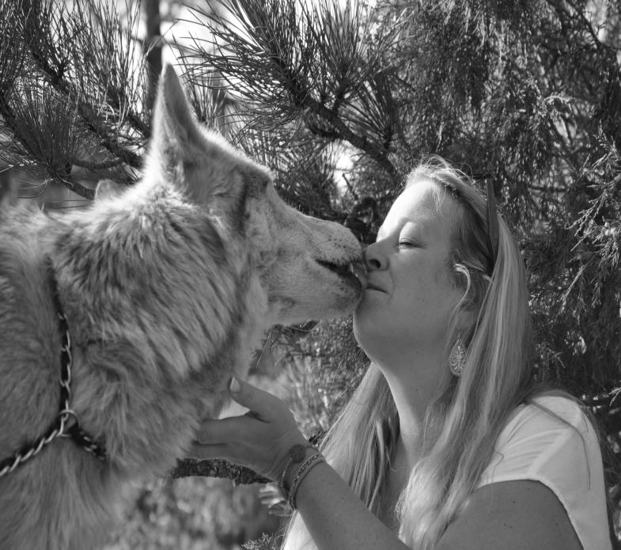
1
WHO ARE
YOU?
Career marketer in: Food, technology,
non profit & wine marketing
NLH
Risk Adverse?

Slide 27
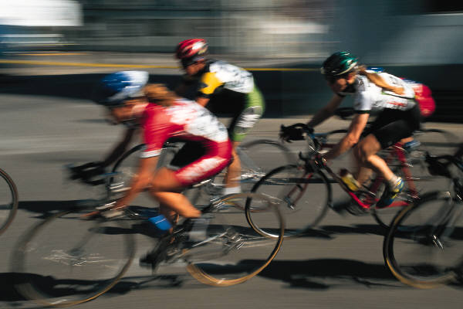
02
John has told us:
“Social marketing is a process for influencing human behavior on a large scale, using marketing principles for the purpose of societal benefit rather than commercial profit.”
(W. Smith, Academy for Educational Development)
TODAY
Goals
SANELY APPLIED ADVERTISING COULD REMAKE THE WORLD
And make it healthier- CGM

Slide 28
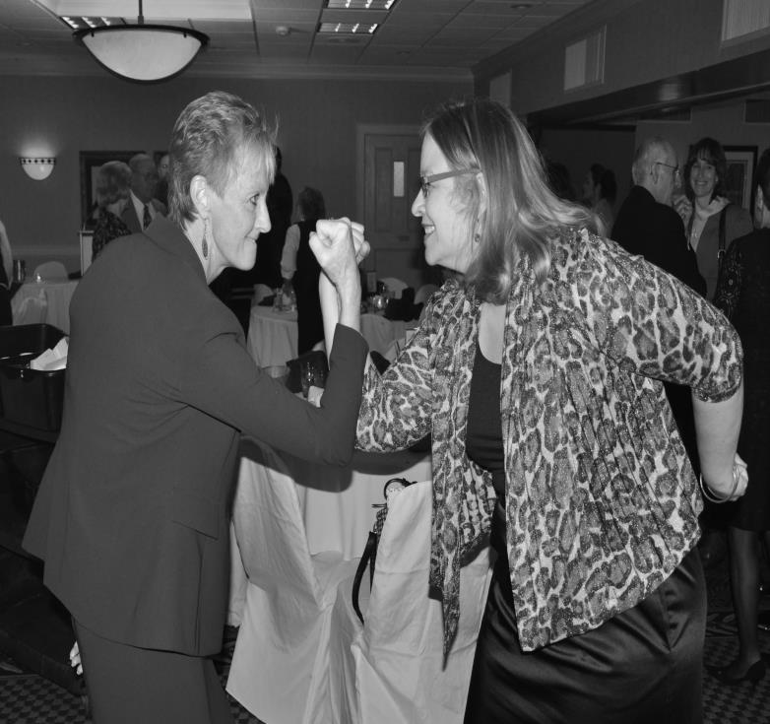
3
You say: Hmm doesn’t ALL healthcare serve a common good?
I say: We don’t act like it.
COMPETITION
Federal Trade Commission:
“Competition in health care markets benefits consumers because it helps contain costs, improve quality, and encourage innovation.“
What do you think?
@
War of “Firsts”, spiral of new technology wars, rating systems

Slide 29
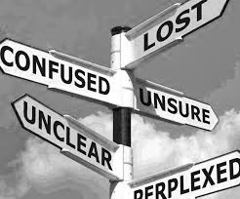
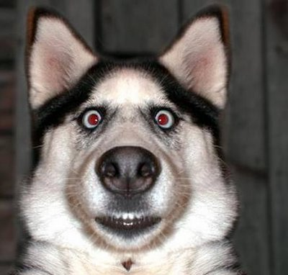
4
OUR CHALLENGE
https://www.youtube.com/watch?v=EizgQEnafOA
DO WE MEET THEM WHERE THEY ARE?
TALK TO THE CONFUSED AND TO THE SELFISH (AKA common good challenged)
https://www.youtube.com/watch?v=4TuEWtXBT_0
HOW?

Slide 30
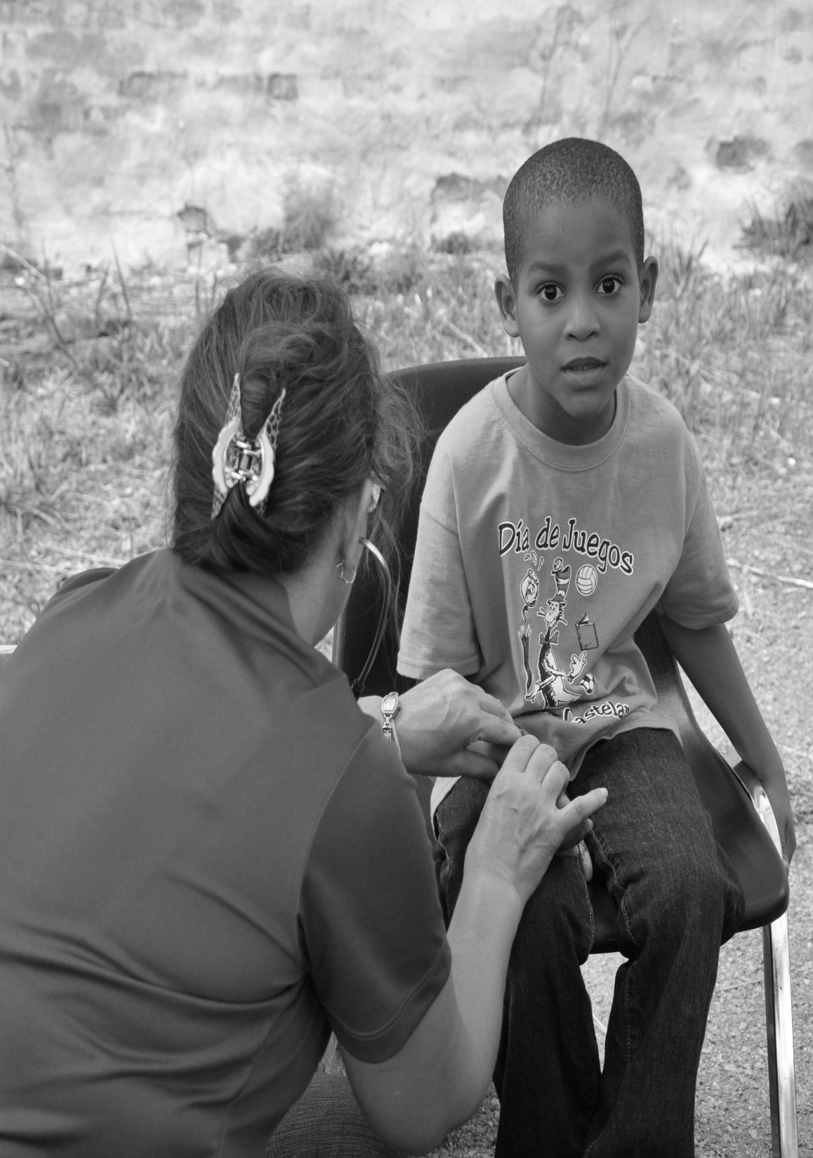
SANELY APPLIED ADVERTISING COULD REMAKE THE WORLD
And make it healthier.
92%
Buy on emotion

Slide 31


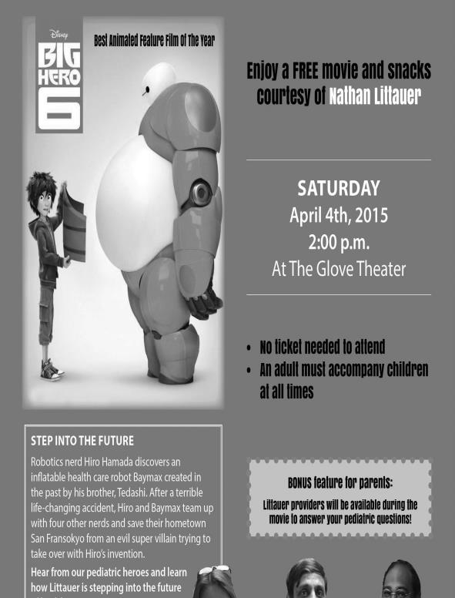
Campaigns
SANELY APPLIED ADVERTISING COULD REMAKE THE WORLD
And make it healthier
3
CREATIVE for us
INEXPENSIVE (mostly)
UNIQUE for us

Slide 32
HA
HUMOR
+ SOCIAL
Not usually our strong suit
We have been able to identify barriers and market to them.
Our goal? Capitalize on our shared common experience.
Common good

Slide 33
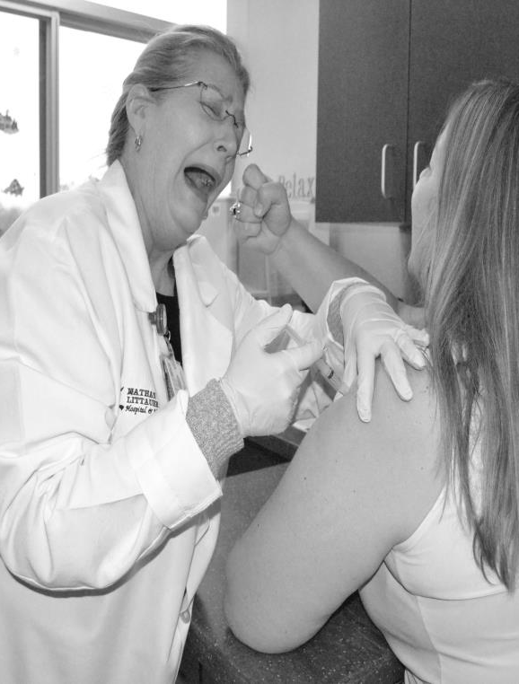
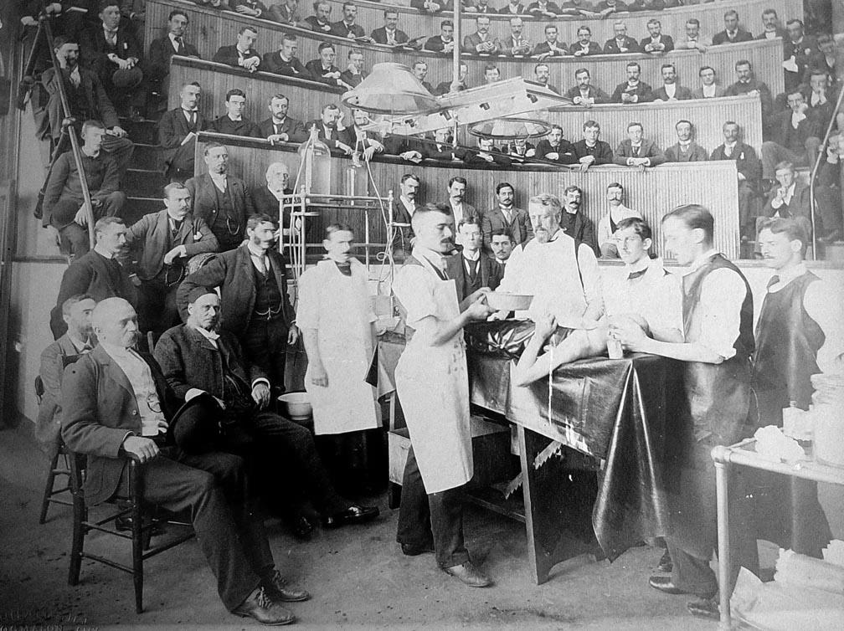
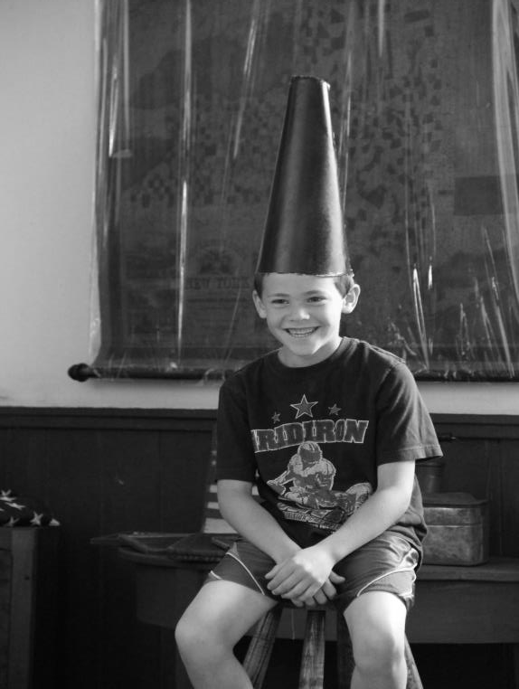
SUSPEND these beliefs
1
2
3
We aren’t funny
We aren’t the right fit for most social platforms
It isn’t dignified
NOT TRUE
Medicine has always been social
Be human
BE HUMAN
BE CREATIVE
BE UNIQUE
BE
FUN
BE
ENTREPRENEURIAL

Slide 34
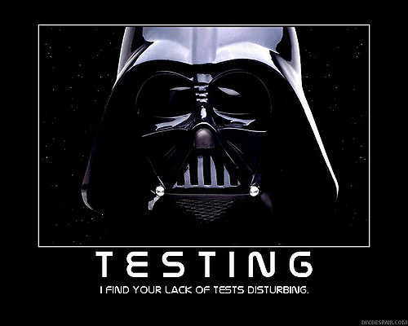
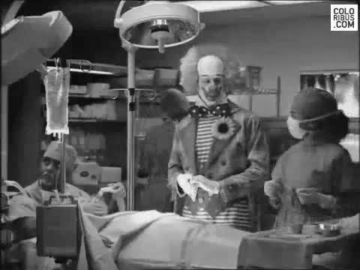
Humor about complex medical care NOT OK
Humor about access and prevention OK
RULE E
Learn THIS rule

Slide 35
The big problem
New Practice
Low medical
literacy
SEO problems
Highest rate of people
dying from colon cancer
FULTON COUNTY
P P
P
P P
P
SEO
EVENT
ADS
BRIBES
Men are not compliant
Behavior change marketing
Social marketing is a process for influencing human behavior on a large scale, using marketing principles for the purpose of societal benefit rather than commercial profit.
The prep is hard

Slide 36
Our channels
Our Channels
Advertising
Social
Print
Radio
TV
Outdoor
Direct Mail
02
Staff and providers
Public Relations
Press releases
Personal pitches
Chamber events
Research
01
03
Patient giveaway
Exclusive Patient Giveaway
04

Slide 37

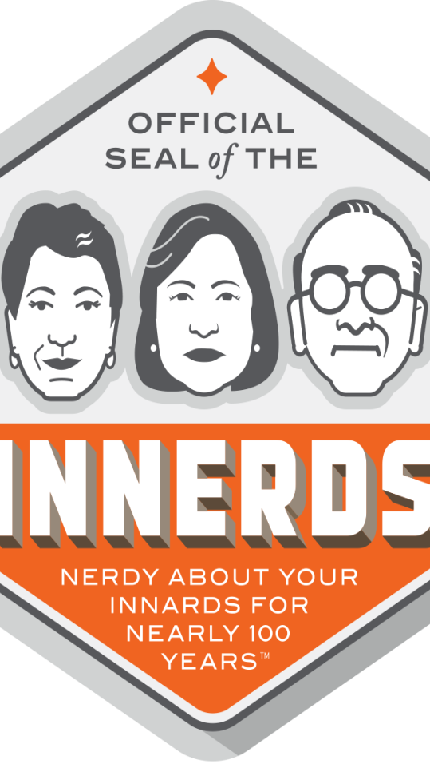



OUR campaign
Nerdy is cool!
National Attention
Sanely applied advertising could remake the world.
And make it healthier
http://www.nlh.org/health-services/gastroenterology

Slide 38
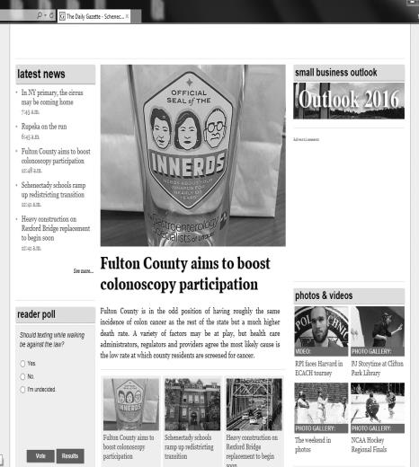
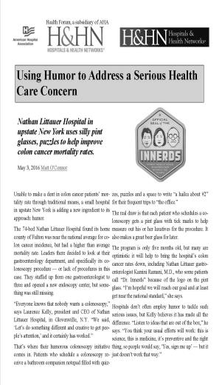
PR
Local Coverage
National
Coverage
Front page
circ. 135,000

Slide 39
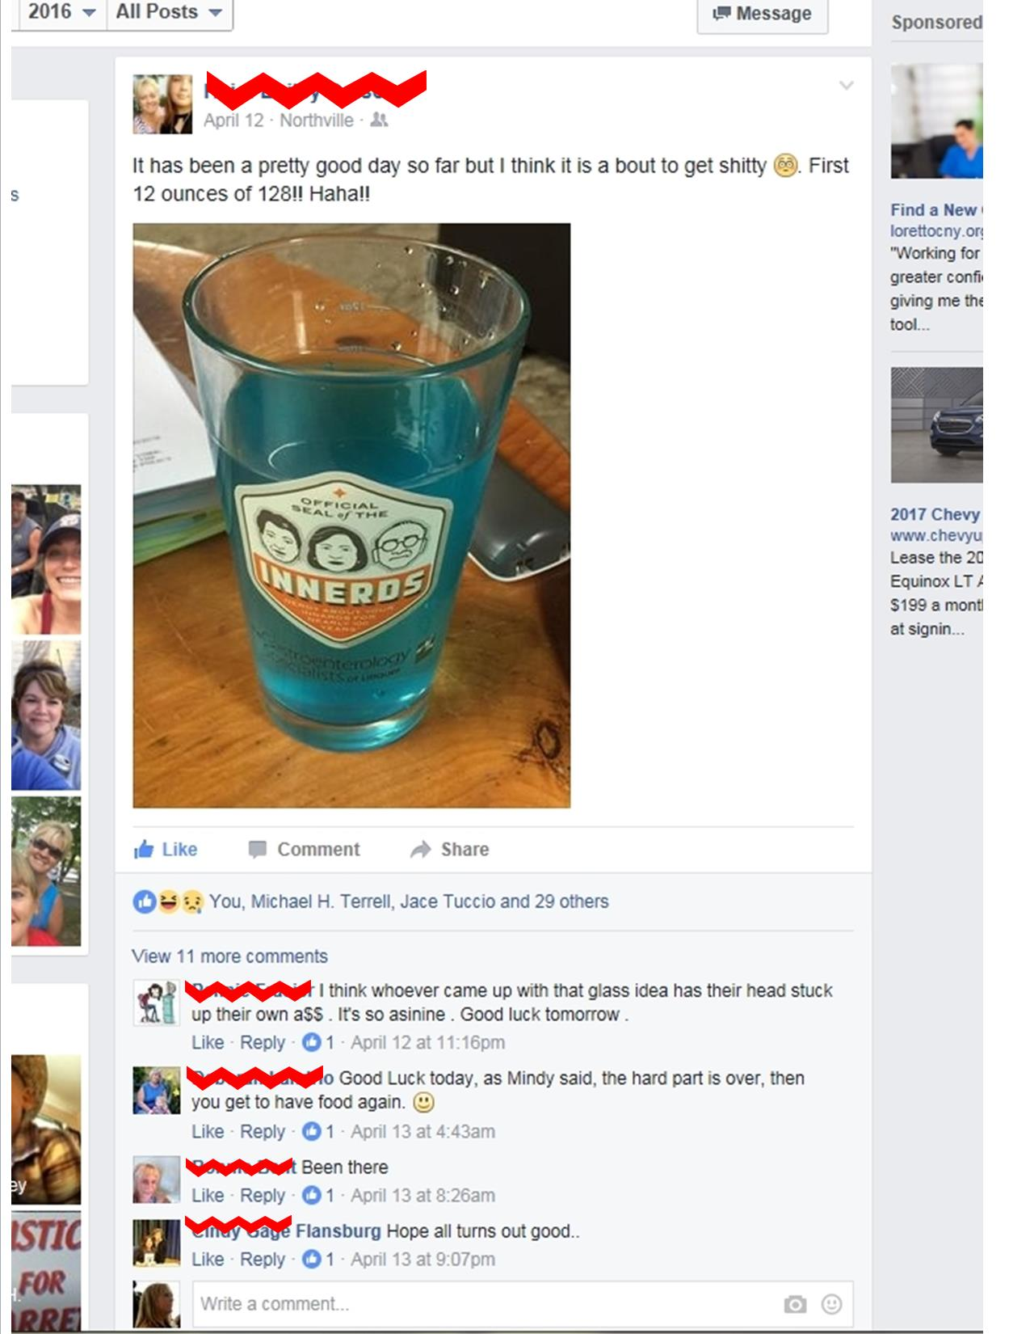
RESULTS?
Average amount of colos per month has increased since the campaign started
= COMMON GOOD
The holy grail

Slide 40
HA
HUMOR
+ THE UNEXPECTED
IT ALL STARTED WITH A SCAR
We have been able to identify barriers and market to them. Our goal? Capitalize on our shared common experience.
Common Good

Slide 41

Ha
OUR BRAG your steal
SANELY APPLIED ADVERTISING COULD REMAKE THE WORLD
And make us all healthier
Take risks

Slide 42


ha
`
Gasp!
CHICKEN WINGS & Private Things
A bar?!
Marketing to the hard to reach
Tea for Pee
Risk & reward

Slide 43
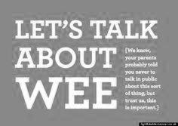
RESULTS?
ACTIVITY | COUNT
Highest attended men’s event ever | 42
Request for another | 2
New referrals | 4
Women’s event attendance | 82
Humor can work

Slide 44
HA
SOCIAL
+ HARD TO REACH
One of the best days of my career
We have been able to identify barriers and market to them. Our goal? Capitalize on our shared common experience.
Common good

Slide 45

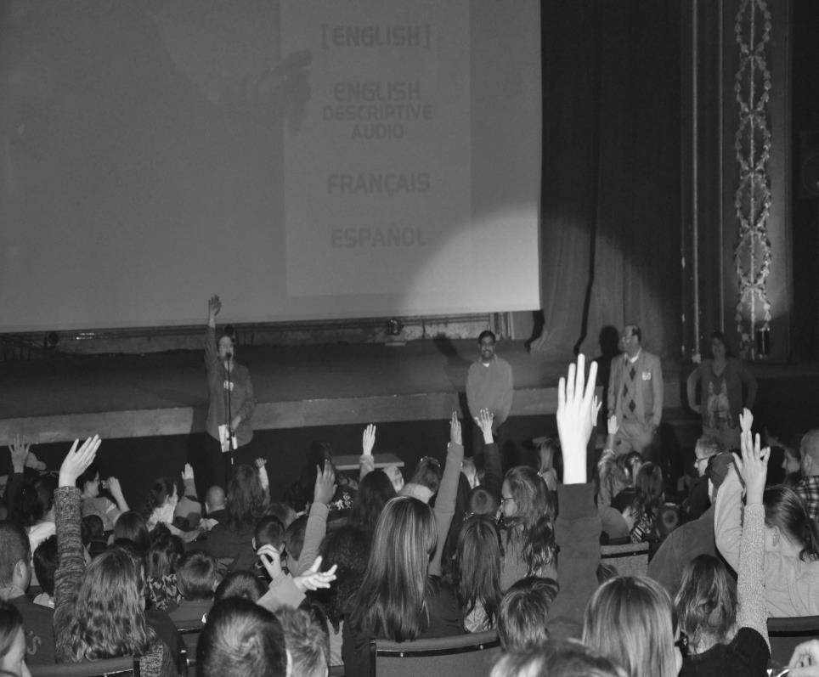
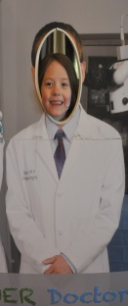
MOVIES WITH A MESSAGE
Big hero 6
Concussion Discussion
Inside Out
$400
No RSVP

Slide 46
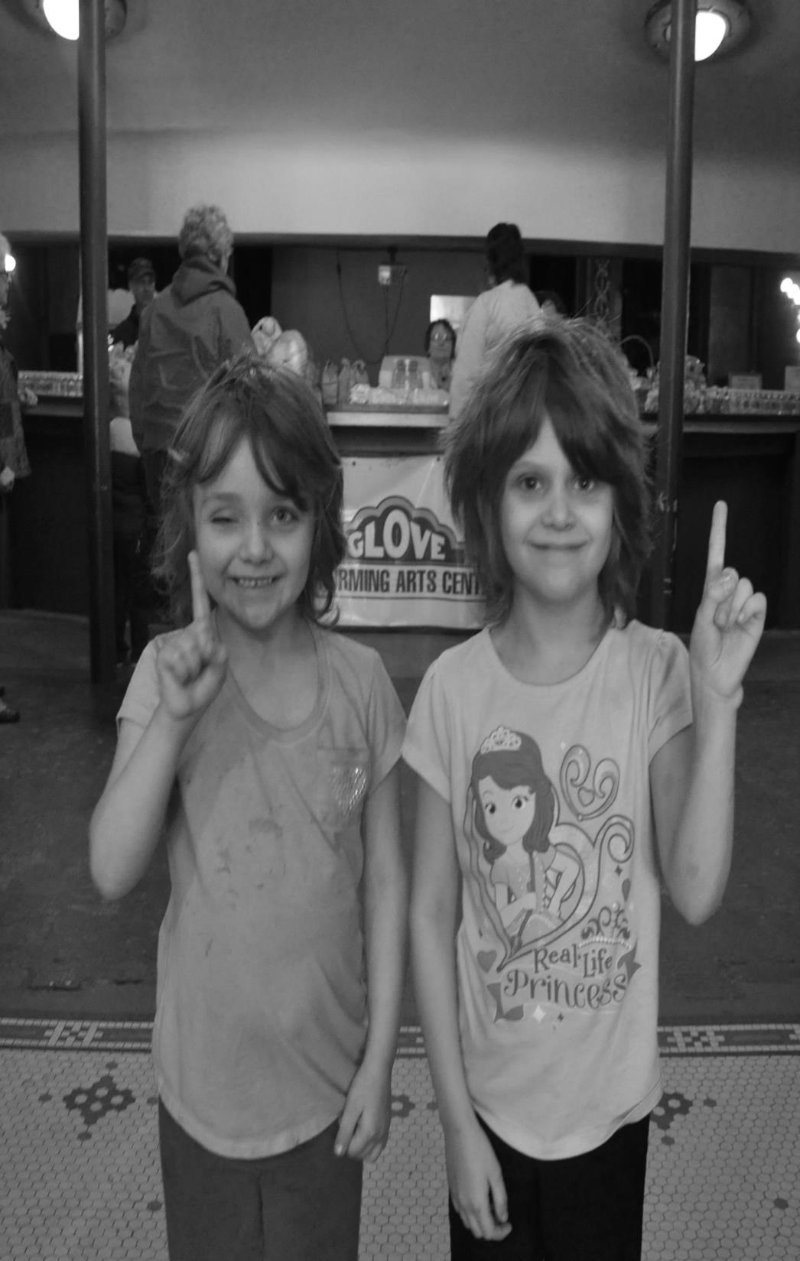
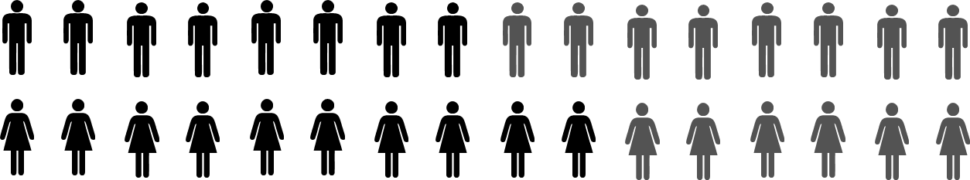
RESULTS?
ACTIVITY | COUNT
Largest event in our history | 500
Referrals | 5
Shared pictures | 25
500+
The holy grail

Slide 47
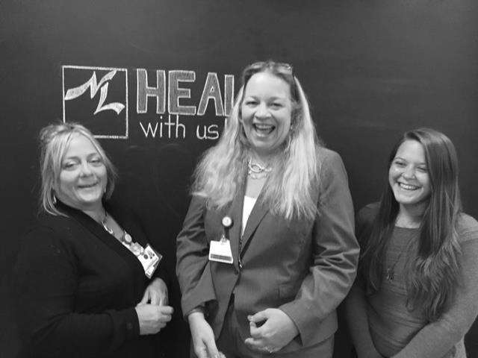
TIPS
SANELY APPLIED ADVERTISING COULD REMAKE THE WORLD
And make us all healthier
FromUS
OUR BRAG your steal
Take risks

Slide 48

Choose a great name
Choose unique delivery methods and channels
High tech & low tech
The INNERDS
Tea for pee
Chicken wings & private things
The Backstage Tour
Concussion Discussion
Fortune cookies
Direct mail
Parking lots

Slide 49
&
OUR TIPS
Take risks
Market to yourself first
Be ready
Make the offline jokes online
Show human- ness
Encourage the creative process
Learn the Pixar Rules of Storytelling
Leadership
Providers
Employees
“Most sales fall down when the customer calls”
TIP 1
TIP 2
TIP 3

Slide 50

I WORK
FOR
THEM
Get RIGHTEOUS
THANK YOU!
Cmcgrattan@nlh.org
518-773-5212
SANELY APPLIED ADVERTISING COULD REMAKE THE WORLD
And save the world

Slide 51
BRAG and steal
Who was your target audience?
What was the behavior change you were striving for?
What communication channels did you use?
What were the results?
Why does your organization consider it a success?
TALK
23
BRAG and steal
Break into groups
TALK
RECORD
REPORT OUT

