Slide 1
What Is a Human Service Value Proposition
Heidi A. Milch, LMSW
Executive Director

Slide 2
Understand what a value proposition is and why it is needed
Understand different customer bases and relationship to agency value prop
Identify value from different perspectives
Understand differences in types of data being collected and relationship to the value proposition

Slide 3
Changes…..
What is the new reality driving the “value” discussion?
Why do we need value propositions?

Slide 4
Steps to get your agency ready for managed care….TODAY we will focus on a piece of packaging and presenting yourself in preparation for contracting

Slide 5
Value is measured by….
Cost (of Care + Cost of doing business)
Right amount of care being delivered
Quality (Outcomes of Care + Satisfaction)

Slide 6
What is a Value Proposition?
A statement/s, not a presentation, using data elements from the 3 circles in the previous diagram
It is used to quickly differentiate the organization from other similar organizations
Clearly articulates benefits provided by the organization to the customer
It is a concise message supported by facts that are relevant to the various audiences/customers

Slide 7
How is a Value Proposition Used?
Marketing and Communication
Contracting
Strategic Planning
Engagement with various stakeholders

Slide 8
A value proposition packages and presents the benefits (value)
that your programs and services provides to the customer.
Value Proposition
Resonate
Differentiate
Substantiate

Slide 9
Value Proposition Components
RESONATE
KNOW YOUR CUSTOMER AND WHAT THEY WANT/NEED TO ACHIEVE
How do your services solve the customers problem/meets their need
What are and how do your services uniquely assist funders (e.g. dsrip, managed care companies) to improve the health and/or well-being of their members?
What are and how do your services help clients (both consumers and funders) achieve their goals

Slide 10
Referrals and Payers ($)
Insurance Company
Health Home/HARP
DOH
Clients + Consumers
Community
City/County/State
Regulatory and Licensing Bodies
Requires process (business and clinical), quality, satisfaction and financial data
WHO IS YOUR CUSTOMER?
Different Customers will need different data in value proposition!
-Dept. of Education
-DOH
-OPWDD
-OASAS
-OMH
Requires data that measures the Triple Aim (cost, quality and satisfaction)
Requires data that shows effectiveness, customer service and satisfaction
Agency XYZ
Requires data that shows inclusion of community stakeholders in processes, quality, cost and client satisfaction

Slide 11
Example: Customer is DSRIP interested in improving outcomes in maternal child health
“Pains”
(frustration, costs, risks the customer has)
“Goals and Tasks”
(what are they trying to achieve)
High Costs
Silos of Care
Regulatory requirements for service delivery and reporting
Preventable hospital admissions
Too much or too little service
Satisfied Customers
Avoidable poor pregnancy outcomes and subsequent hospitalizations
Increase immunization rates
Decrease rate of low-birth weight babies
Increase access to quality pre-natal care
Integrated physical and behavioral health
What services that you provide will RESONATE with the DSRIP?
What do you do that can address their pains and goals?

Slide 12
Value Proposition Components
Why you? How are you different?
DIFFERENTIATE
A clear statement that tells the customer why they should buy from you and not from the competition
Know your customer and what data speaks to them
Use comparative data from other providers, rest of state, etc.

Slide 13
Value Proposition Components
SUBSTANTIATE
YOU MUST HAVE DATA
A clear statement that explains how your services delivers specific benefits (quantified value)
How are your clients better from being in your program?
OUTCOMES, OUTCOMES, OUTCOMES
Know the outcomes the contracting customer is looking for…..do you have the data showing you deliver on what they need?

Slide 14
What types of data is needed ?
Process Data
Counts
Fiscal/Cost
Productivity
Satisfaction
Outcome Data
Changes in client as a result of intervention
Improvements made in target population
Notes:
Productivity data = how many clients does each worker see per day, per week per month, how many outreach vs, engaged

Slide 15
Examples of Process Data to Have * Needed for performance management * Needed for Quality Improvement * Needed to construct a value proposition
Fiscal Metrics
Income/revenue by program and service line
Total cost (direct+indirect) per service unit per program (and then service line, program)
Compare to total reimbursement per service unit and service line
Profit/loss per service line
Number of service units billed
Per week, per month
% billing accepted/rejected (and reasons)
By service line
By worker
“Count” Data
Number of service units delivered
By service line, worker
Number of referrals
By referral source
Number of clients seen within XX days of referral
Number of reportable client “incidents”
Number of clients who return after first visit, second visit
Rate of staff turnover (how many hired, how many fired or quit)
By program and supervisor
Cost to “on-board” new staff

Slide 16
Examples of Outcome Data
Outcome = client/consumer change in behavior, attitude, knowledge or circumstance
WHAT ARE YOU TRYING TO ACHIEVE?
Defined outcomes
HEDIS and QARR Measures
Decrease in admissions to ER
Decrease in re-admissions to inpatient
NCQA Standards
Accrediting Bodies
EBP Outcome Measures
Regulatory Agencies (OPWDD, OASAS, OCFS, OMH, Dept. of Education, DOH)
DSRIP
Health Homes
Standardized Measures:
CANS-NY, PHQ-9, AQoL, etc.
Agency Outcomes
Outcomes that Measure Mission
Agency defined outcome measures
Supervisor/Staff input
Client/Consumer/Customer Achievement

Slide 17
How much did we do – process data
Counts
People served
Activities completed
How well did we do it – process data
Timeliness %
Attendance levels
Satisfaction of customers
Cost per Program, service line, staff
Revenue per Program, service line, staff
Standards met (% of)
Is anyone better off? (what difference did we make) – outcome data
Behavior Change (#,%)
Decrease in hospitalization rates
Skills Improve (#, %)
Client Achievement (how are they different as a result of your intervention)
Circumstances Change (#,%)
Stable housing
Sobriety maintained for XXX months

Slide 18
Example: Home Visiting Program
What we do
# Clients
By Age Group
By Race
# of Referrals to PCP’s
# of home visits
# of well visits to pediatrician
# of clients with up to date immunizations
How well we do it
% assessments completed on time
% of clients seen within 7 days of referral (and 14)
% of satisfied clients
% of clients who complete program
Average length of Stay in program
% of clients immunized and attendance at all child well-visits
Is anyone better off?
#,% of clients who implemented positive parenting practices
#, % of clients who improved maternal health
#, % of mothers who gained employment
#, % of homes with fewer hazards
#,% of kids with up-to-date immunizations
Notes:
#, % of children with <2 visits to the emergency room – what is baseline for your population now? Do you know if your clients have less?

Slide 19
Example: Developmental Disabilities
What we do
# Clients
# Clients who self direct their supports and services
# of Services Provided by type
# of clients in education or vocation program
# of clients working or volunteering
# of Individualized Plans completed
# of goals achieved on Individualized Plans
# of Referrals Completed
How well we do it
% of individualized plans completed on time
% of individualized plans reviewed at XX months
Waiting List
% of clients who self direct their supports and services
% of satisfied clients
% of clients following through on referrals
% of clients working or volunteering
% of clients active in education or vocation program
Is anyone better off?
#, % of clients with goal achievement
#, % of clients with increase in skills
#,% of clients who transition to community based employment
#, % of clients in stable community housing
% of clients successfully completing education or vocation program

Slide 20
What makes a good written value proposition:
Clarity! It’s easy to understand.
It communicates the concrete results a customer will get from being in your program/receiving your services.
VALUE = cost/quality
It says how you are different or better than a competitor (with specific data)
It avoids hype and jargon
No other agency can do what we do
We are the best
We serve the most difficult clients

Slide 21
Constructing Your Value Proposition (just one format of many options out there)
Identify the audience for this value prop
Headline. What is the end-benefit you’re offering, in 1-2 sentences.
Resonate with your identified customers needs and goals here
Attention grabber. What you have data for.
Sub-headline or a 2-3 sentence paragraph.
A specific explanation of:
what you do for whom (target pop, mission)
how well you do it (differentiate your program from others here using data)
How are people better off (substantiate using specifics and data here)
3 bullet points. List the key benefits that will resonate with customer needs.
Example of what can go here: capacity, engagement metrics, customer satisfaction rates, geographic access benefits
Notes:
For today, hypothesize the 3 bullet points given what you know. Take this back to your agency, complete charts on slides 17-20 and see if it changes your value prop.

Slide 22
Example Value Proposition
headline
92% of our families receive skills and services that promote successful family lifestyles as measured by gainful employment, living wages, healthy lifestyles, and engagement in a variety of socially productive behaviors.
We are a leading provider of maternal and children’s health services in Western New York successfully serving # of clients each year. We define success by (list a how well we do it here) and 92% of our clients say they would not hesitate to refer a friend or family member to our programs.
Families/Mothers in our program consistently:
1. X% Receive nutrition services
2. X% Receive health services and have 95% attendance at well visits, immunizations and health screenings compared to 72% in same age group in the general population
3. X% of parents report they apply the skills learned on how to create a nurturing home environment for the children
4. Our clients have 15% less emergency room visits than their community counterparts saving X$ per year.
Services that we provide that help our clients achieve their desired outcomes include:
Home visiting program for women with children birth to age 5
Transportation assistance
24 hour telephone support
Educational and support groups
Subheadline – what you do, how well you do it,
Key features – services and outcomes, how people are better off

Slide 23
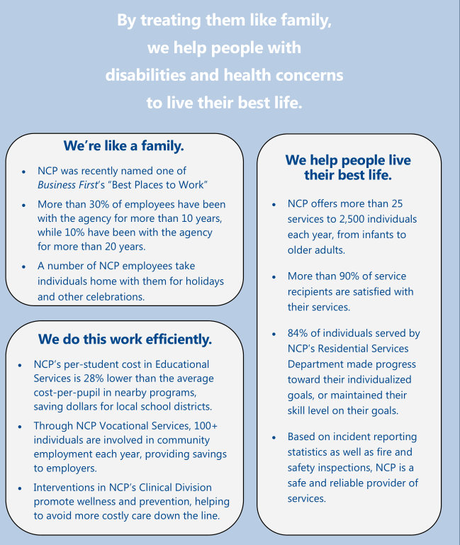
Example 2 –
Audience/customer is unclear
How can you tell?
Is there value in presenting the
Internal HR/employee metrics?
yes/no?
(discuss – what does this
Type of data tell you)
What additional data would be
important to add in the
Efficiency Section?
Do you think this
Communicates the agencies
Value?

Slide 24
Example 3
AGENCY ABC
Suggested improvements?

Slide 25
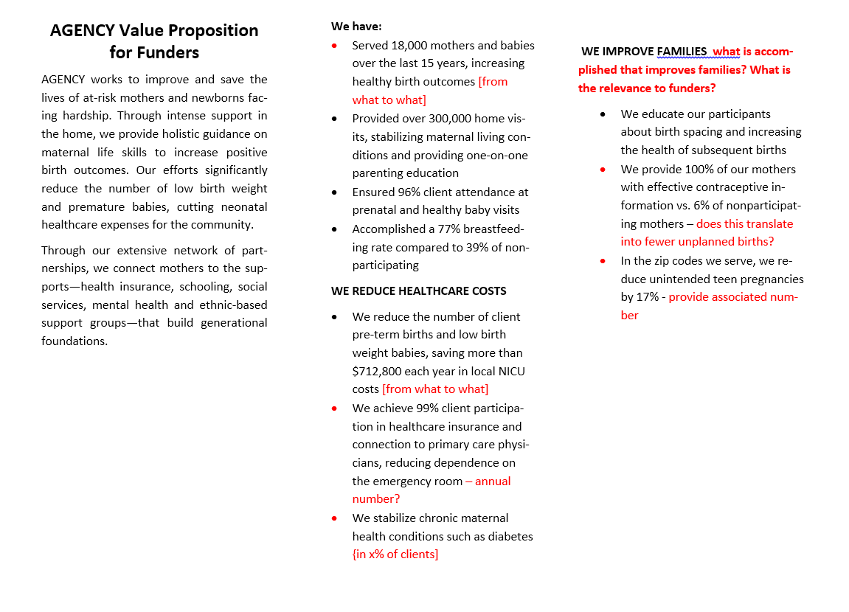
EXAMPLE 4 -

Slide 26
Walk through a framework to “organize” your agency process and outcome data for use in a value proposition
Tool/framework to cross reference what services/products you provide against what contractors will pay for and/or what they value
How to Align (map out):
What you do
What they will pay for
What is causing them pain (what they must address)
Their goals
Constructing a sample value prop
step by step

Slide 27
Heidi A. Milch
Executive Director
hmilch@ccnyinc.org
www.comconnectionsny.org
(716) 855-0007

